Slide 1



Weekly Review
Gobind Sugar Mill, Aira
11th Jan. to 17th Jan. 2026

Slide 2
Production & Sales (Budget vs Actual)
Production (F.Y. 2025-26)
Particulars | Current Month (Jan,26) |  | Last Month (Dec,25) |  | YTD Till Last Month (Up to Dec,25)
 | Budgeted | Actual-till 17th, Jan-26 | Budgeted | Actual | Budgeted | Actual
Sugar (LQ) | 2.77 | 1.51 | 2.73 | 2.89 | 5.59 | 5.51
Power (LU) | 276.05 | 157.48 | 281.23 | 286.80 | 759.33 | 747.19
Ethanol (LL) | 30.00 | 20.60 | 37.20 | 36.17 | 272.91 | 268.60
Sales (F.Y.2025-26)
Particulars | Current Month (Jan ,26) |  | Last Month (Dec,25) |  | YTD Till Last Month (Up to Dec,25)
 | Budgeted | Actual-till 17th, Jan-26 | Budgeted | Actual | Budgeted | Actual
Sugar (LQ) | 1.25 | 0.46 | 0.94 | 0.97 | 10.63 | 10.45
Power (LU) | 163.94 | 94.78 | 165.81 | 167.09 | 382.83 | 382.20
Ethanol (LL) | 30.00 | 18.33 | 37.20 | 37.65 | 272.91 | 269.44
Notes:
Dec-25 Sugar Sale Free 91140 Qtls & Export 6090 Qtl Total=97230 Qtls
Jan-26 Sugar Sale Free-41814 qtl & Export 4130 Qtl Total=45914 qtl

Slide 3

SPE Weekly Snapshot
Production Parameters | Current Week | Last Week | Till Date
Total Sugarcane Crush (LQ) | 7.34 | 7.37 | 84.77
Sugar Recovery | 9.91% | 9.66% | 9.91%
Cane for Syrup (LQ) | 1.12 | 1.17 | 13.94
Sugar Produced (LQ) | 0.63 | 0.64 | 7.02
Ethanol Produced (LL) | 8.36 | 8.57 | 94.44
Power Generation (LU) | 65.26 | 65.43 | 766.81
Power Export (LU) | 39.18 | 39.79 | 454.70
Cane Payment (Cr) | 25.12 | 25.14 | 269.04
Capacity Utilization | Current Week | Last Week | Till Date
Season Days | 7 | 7 | 84
Milling PUF | 104.93% | 105.29% | 100.56%
Sugar Bagging (Nos.) Actual/Capacity | 63366/61691 | 62593/59846 | 701761/701955
Power PUF | 97.12% | 97.37% | 95.09%
Distillery PUF | 95.49% | 97.78% | 95.64%
Bagasse Pol % | 1.72% | 1.72% | 1.75%
Bagasse Moisture | 50.05% | 50.16% | 50.14%
3

Slide 4
SPE Weekly Snapshot – Total Losses
This Week | Last Week | Till Date
3.18 | 3.42 | 2.31
4
Notes:
Pol in Cane

Slide 5
Comparison with Nearby as on 17.01.26
5

Slide 6
Pol Balance as on 17.01.26
6

Slide 7
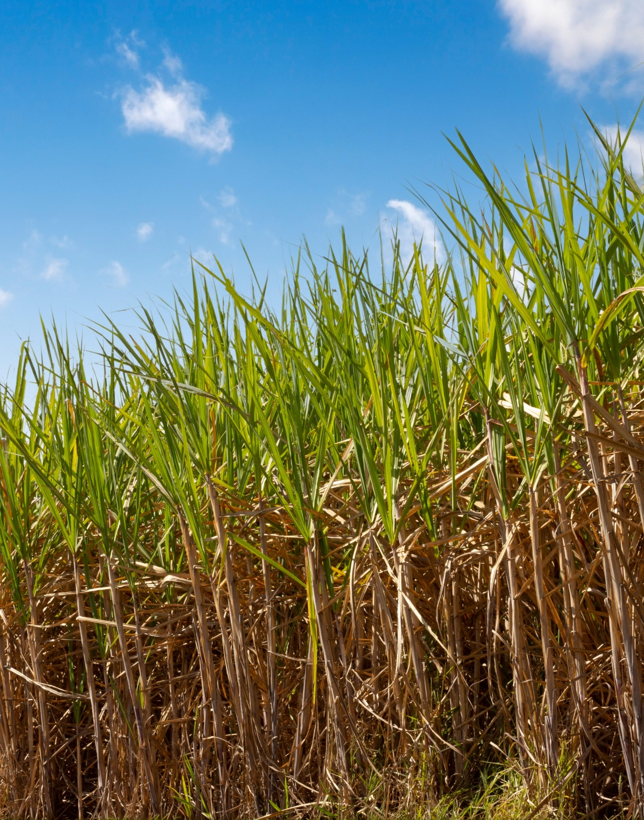
CANE

Slide 8
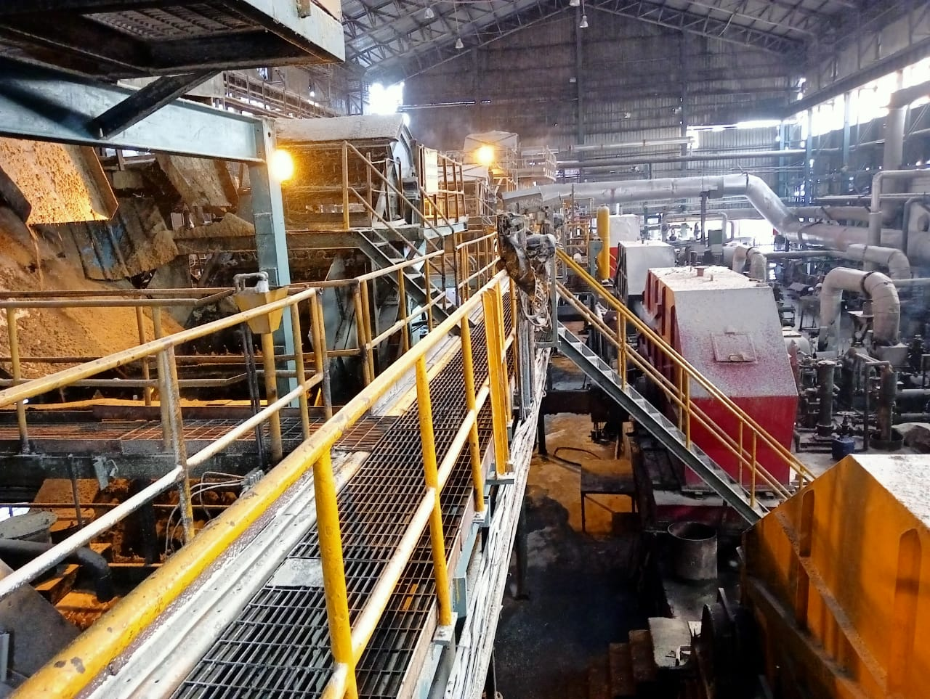
ENGINEERING

Slide 9
Mill No-3 both jiuce line to Mill No-2 found choked with bagasse and Cleaned.
Mill No-3 both jiuce line to Mill No-2 found choked with bagasse and Cleaned.
Mill No-3 both jiuce line to Mill No-2 found choked with bagasse and Cleaned.
Mill No-3 both jiuce line to Mill No-2 found choked with bagasse and Cleaned.
General Observations of the Week
The plant operation was smooth and consistent in last week. In Last week total 7.345 L Qtls. cane crushed @ 1.049/day.
On Dated 13.01.26: Initially feeder drum tripped on overload. then IRC No-4 Chain tail shaft support got broken & Mill No-3 both juice line to Mill No-2 found choked with bagasse and Cleaned stoppage 1.49 Hrs .
Dated 16.01.& 17.01: Crush regulated due to shortage of Cane ( 1.02 & 1.035)
Particulars | Weekly |  | Till Date
 | SN. 25-26 | SN. 24-25 | SN. 25-26 | SN. 24-25
Hours Worked | 166.11 | 166.47 | 1978.54 | 1976.23
Hours Available | 168.00 | 168.00 | 2016.00 | 2016.00
Hours Utilized (%) | 98.92 | 99.28 | 98.16 | 98.03

Slide 10
Key Operational Parameter- Current Season Vs Last Season
Particulars | Weekly |  | To date
 | SN 25-26 | SN 24-25 | SN 25-26 | SN 24-25
Cane Crushed (In Qtls.) | 734500 | 695800 | 8477200 | 7867700
Rate of Crush | 104929 | 99400 | 100919 | 93663
Pol % Bagasse | 1.72 | 1.72 | 1.74 | 1.76
Loss in Bagasse % Cane | 0.49 | 0.46 | 0.49 | 0.48
Moisture % Bagasse | 50.05 | 49.60 | 50.13 | 50.08
Total Power kw/ Ton of cane | 30.72 | 32.04 | 31.87 | 32.64
Total Power MWH (Sugar) | 10.96 | 10.67 | 10.96 | 10.15
Lubricant Consumption. | 0.04 | 0.04 | 0.04 | 0.04

Slide 11
Weekly Performance Snapshot - Engineering
S.No. | Capacity Utilization | Target 2025-26 | Current Week. ( 11.01.26 to 17.01.26) | Last Week | Till Date (17.01.2026)
1 | Cane Crushed (LQ) (192 Days) | 179.00 | 7.345 | 7.37 | 84.772
2 | Hours Utilized (%) | 99.17 | 98.92 | 99.41 | 98.16
3 | Downtime (Hrs.) | 72.00 | 1:49 | 0.59 | 21:50
4 | Planned Stoppage (Hrs.) | 48.00 | 0.00 | 0.00 | 18:08
5 | Forced Shutdown (Hrs.) | 24.00 | 1:49 | 0.59 | 16:02
6 | Capacity Utilization in Uptime @ 1 LQ / Day Base (%) | 94.71 | 106.08 | 105.91 | 102.81
7 | Capacity Utilization incl. Stoppage (%) | 93.22 | 104.93 | 105.29 | 100.92
 | Quality
1 | Pol % Bagasse | 1.65 - 1.70 | 1.72 | 1.72 | 1.74
2 | Moisture % Bagasse | 49 - 49.5 | 50.05 | 50.17 | 50.13
 | Consumption
1 | Steam Consumption (KG/Qtl Cane) | 5.0-6.0 | 4.89 | 4.92 | 4.92
2 | Power Consumption (KW/T Cane) | 31.5 - 32 | 30.72 | 29.82 | 31.87
3 | Lubricant Consumption (Kg/100 Qtl Cane) | 0.04 | 0.04 | 0.04 | 0.04
11

Slide 12
Monthly figure
Plant Performance in Season 25-26
Sr No | Particulars | Unit | Season 25-26
 |  |  | Target | Achieved (17.01.2026)
1 | Total Cane Crushed | Qtls | 17900000 | 8477200
2 | Date of Start | Date | 20/10/2025 | 26/10/2025
3 | Date of Finish | Date | 23/04/2026 | -
4 | Gross Season Days | Nos | 192 | 84
5 | Crushing rate Including Stoppage | Qtls | 93229 | 100919
6 | Crushing rate Excluding stoppage | Qtls | 94709 | 102811
7 | Capacity Utilization | % | 94.71 | 102.81
8 | Total Stoppage Hours | Hrs. | 72.00 | 37.06
9 | Planned Shutdown | Hrs. | 48.00 | 18.08
10 | Forced Shutdown | Hrs. | 24:00 | 16.02
11 | Preparatory index | % | 90.0-91.0 | 90.18
12 | Primary Extraction | % | 70.5-71.0 | 71.34
13 | Mill Extraction ( ME) | % | 96 - 96.5 | 95.99
14 | Reduced mill Extraction (RME) | % | 96.4 - 96.80 | 96.26
15 | Bagasse % Cane | % | 29.00 | 28.04
16 | Pol % Bagasse | % | 1.65-1.70 | 1.74
17 | Moisture % Bagasse | % | 49.0 - 49.5 | 50.13
18 | Imbibition % Cane | % | 40 Max | 37.25
19 | Imbibition % Fibre | % | 290 - 295 | 280.16
20 | Dry Milling Factor | % | 71.25 | 71.55
21 | Grease & Lubricants Kg/100 Qtls Cane | % | 0.04 | 0.04
22 | Power Consumption ( KW/T Cane) | % | 31.5 - 32 | 31.87
23 | Steam Consumption Sugar (Kg/Q of Cane) | % | 5.0-6.0 | 4.92
12

Slide 13
Stoppages, Actions & RCA for the Week
Stoppage Details Crushing Season 2025-26
S NO | Report Date | Head | Section | Equipment Name | Type | From | To | Duration in Hrs | Stoppages Reason
115 | 11/01/2026 | Mechanical | Cane Preparation | Feeder Drum | Forced Shutdown | 11/01/2026 18:39 | 11/01/2026 18:41 | 0:02:00 | Feeder Drum Tripped Due to high load
116 | 13/01/2026 | Mechanical | Cane Preparation | Feeder Drum | Forced Shutdown | 13/01/2026 12:25 | 13/01/2026 13:20 | 0:55:00 | Initially feeder drum tripped on overload. Then IRC No-4 Chain tail shaft support got broken.
117 | 13/01/2026 | Mechanical | Mill | Mill No-3 | Forced Shutdown | 13/01/2026 13:32 | 13/01/2026 14:24 | 0:52:00 | Mill No-3 both juice line to Mill No-2 found choked with bagasse and Cleaned.
 |  |  |  |  |  |  | Total | 1:49
Note: To control the overloading on feeder drum, a hooter with light provided at kicker on dated 18.12.25, positive result seen but still its under observation

Slide 14
Total Stoppages CONPARETIVE SUMMARY - INCIDENCE REPORT Mill Stoppage.
S.NO | PARTICULAR | SEASON 2019-20 | SEASON 2020-21 | SEASON 2021-22 | SEASON 2022-23 | SEASON 2023-24 | SEASON 2024-25 | SEASON 2025-26
A | Mechanical Stoppage Details
1 | CANE UNLOADER | 00:00:00 | 00:45:00 | 00:13:00 | 00:15:00 | 00:00:00 | 00:00:00 | 00:00:00
2 | CANE CARRIER | 68:17:00 | 01:51:00 | 08:48:00 | 07:19:00 | 00:18:00 | 01:56:00 | 01:04:00
3 | CANE JAMMING NEAR CANE KICKER | 01:01:00 | 00:52:00 | 00:00:00 | 00:19:00 | 00:00:00 | 00:28:00 | 00:00:00
4 | FEEDER DRUM TRIPPED | 02:40:00 | 02:07:00 | 00:08:00 | 00:00:00 | 00:17:00 | 01:46:00 | 03:15:00
5 | SHREDDER | 01:39:00 | 07:31:00 | 00:40:00 | 38:46:00 | 105:00:00 | 02:29:00 | 03:33:00
6 | SHREDDER KICKER | 03:28:00 | 00:00:00 | 00:00:00 | 00:00:00 | 00:00:00 | 00:00:00 | 00:00:00
7 | CANE BELT CONVEYOR | 00:12:00 | 01:10:00 | 00:00:00 | 00:00:00 | 12:48:00 | 00:12:00 | 00:00:00
8 | RAKE CARRIER & INTER CARRIER | 26:35:00 | 05:00:00 | 17:43:00 | 09:30:00 | 09:08:00 | 03:13:00 | 06:30:00
9 | MILLS | 04:30:00 | 20:56:00 | 08:01:00 | 02:00:00 | 03:54:00 | 00:34:00 | 01:13:00
10 | DONALLY CHUTE | 00:00:00 | 10:26:00 | 06:29:00 | 02:22:00 | 00:50:00 | 01:58:00 | 00:08:00
11 | JUICE TRAY JAMMING | 00:00:00 | 01:38:00 | 00:00:00 | 00:00:00 | 00:00:00 | 00:00:00 | 00:00:00
12 | TURBINE | 03:28:00 | 00:50:00 | 01:29:00 | 00:00:00 | 00:24:00 | 00:00:00 | 00:29:00
13 | BOILING HOUSE | 03:57:00 | 00:00:00 | 05:21:00 | 00:49:00 | 01:15:00 | 00:00:00 | 00:00:00
14 | Total Mechanical (MILL & BH) | 115:47:00 | 53:06:00 | 48:52:00 | 61:20:00 | 133:54:00 | 12:36:00 | 16:12:00
B | Total Stoppage Details
1 | NO CANE | 162:44:00 | 101:22:00 | 63:23:00 | 43:36:00 | 42:40:00 | 32:55:00 | 0:00:00
2 | WEATHER | 00:00:00 | 00:00:00 | 20:39:00 | 00:00:00 | 00:00:00 | 0:00:00 | 0:00:00
3 | CRUSH REDUCE | 00:00:00 | 01:51:00 | 02:43:00 | 04:05:00 | 15:55:00 | 0:00:00 | 0:00:00
4 | MECHANICAL | 115:47:00 | 53:10:00 | 48:52:00 | 61:20:00 | 135:54:00 | 12:36:00 | 16:12:00
5 | PROCESS | 00:40:00 | 00:24:00 | 02:00:00 | 00:00:00 | 00:00:00 | 0:00:00 | 0:00:00
6 | GENERAL CLEANING | 41:31:00 | 45:05:00 | 54:09:00 | 97:53:00 | 58:04:00 | 35:15:00 | 12:20:00
7 | GROWER STRIKE | 56:48:00 | 12:00:00 | 00:00:00 | 00:00:00 | 00:00:00 | 0:00:00 | 0:00:00
8 | MISE | 20:39:00 | 00:55:00 | 02:40:00 | 00:45:00 | 02:41:00 | 4:37:00 | 6:04:00
9 | ELECTRICAL | 05:29:00 | 04:45:00 | 03:00:00 | 11:33:00 | 02:13:00 | 9:12:00 | 0:20:00
10 | BOILER | 23:00:00 | 11:59:00 | 06:23:00 | 29:48:00 | 00:26:00 | 2:53:00 | 2:10:00
11 | INSTRUMENT | 00:56:00 | 00:30:00 | 00:00:00 | 00:12:00 | 02:04:00 | 0:18:00 | 0:00:00
12 | TOTAL STOPPAGE | 427:34:00 | 232:01:00 | 203:49:00 | 249:12:00 | 259:57:00 | 97:46:00 | 37:06:00

Slide 15
Monthly Comparative Data (Season 2023-24 to 2025-26)
S No | Description | Unit | Crushing Season 2025-26 |  |  | Crushing Season 2024-25 |  |  | Crushing Season 2023-24
 |  |  | November | December | January | November | December | January | November | December | January
1 | Total Cane Crushed | Qtls. | 3055700 | 3247100 | 1749000 | 2777600 | 3062400 | 3097600 | 862300 | 2724600 | 2902400
2 | Gross Season Days | Nos | 30 | 31 | 17 | 30 | 31 | 31 | 15 | 31 | 31
3 | Crushing rate Including Stoppage | Qtls | 101857 | 104745 | 102882 | 92587 | 98787 | 99923 | 57487 | 87890 | 93626
4 | Crushing rate Excluding stoppage | Qtls | 103620 | 106419 | 105800 | 93869 | 100877 | 103476 | 63146 | 97583 | 96082
5 | Total Hrs Available | Hrs | 720:00 | 744:00 | 408:00 | 720:00 | 744:00 | 744:00 | 360:00 | 744:00 | 744:00
6 | Days Worked | Nos | 29.49 | 30.51 | 16.53 | 29.59 | 30.36 | 29.94 | 13.66 | 27.92 | 30.21
7 | Hrs Worked | Hrs | 707:45 | 732:18 | 396:45 | 710:10 | 728:35 | 718:27 | 327:44 | 670:06 | 724:59
8 | Capacity Utilization | % | 98.30 | 98.43 | 97.24 | 98.63 | 97.93 | 96.57 | 91.04 | 90.07 | 97.44
9 | Total Stoppage Hours | Hrs. | 12:15 | 11:42 | 11:15 | 9:50 | 15:25 | 25:33 | 32:16 | 73:54 | 19:01
10 | Above 100000 Qtls Cane Crushing | Days | 25 | 30 | 16 | 19 | 22 | 26 | 0 | 13 | 20
11 | Highest Cane Crushing in Days | Qtls | 108500 | 110000 | 108000 | 102000 | 104000 | 109000 | 90200 | 101000 | 102500
12 | Pol % Bagasse | % | 1.76 | 1.71 | 1.72 | 1.80 | 1.72 | 1.73 | 1.86 | 1.91 | 1.93
13 | Moisture % Bagasse | % | 50.18 | 50.05 | 50.12 | 50.34 | 49.73 | 49.50 | 51.39 | 50.38 | 49.89
14 | Power Consumption ( KW/T Cane) | % | 32.21 | 32.05 | 31.19 | 33.07 | 32.71 | 31.73 | 37.00 | 31.55 | 32.67

Slide 16
Sugar Power Consumption Breakup ( MWH) 11.01.2026 to 17.01.2026
Sugar Power Consumption Breakup ( MWH)
S No | Date | Cane Crushed (QTLS) |  | SHREDDER-1&2 (MW/Hrs.) |  | Zero & 4th Mill (MW/Hrs.) |  | DS House (MW/Hrs.) |  | Raw & Ref. House (MW/Hrs.) |  | Total Power Consumption
 |  | 24-25 | 25-26 | 24-25 | 25-26 | 24-25 | 25-26 | 24-25 | 25-26 | 24-25 | 25-26 | 24-25 | 25-26
77 | 11-Jan | 106000 | 108000 | 3.59 | 3.45 | 0.89 | 0.87 | 1.92 | 2.24 | 1.94 | 2.24 | 10.66 | 10.99
78 | 12-Jan | 100000 | 106000 | 3.33 | 3.44 | 0.81 | 0.85 | 2.26 | 2.20 | 2.30 | 2.17 | 11.01 | 10.91
79 | 13-Jan | 102500 | 100000 | 3.41 | 3.27 | 0.84 | 0.80 | 1.98 | 2.19 | 2.12 | 2.19 | 10.65 | 10.59
80 | 14-Jan | 104000 | 108000 | 3.61 | 3.57 | 0.86 | 0.86 | 1.99 | 2.20 | 1.96 | 2.24 | 10.83 | 11.07
81 | 15-Jan | 97400 | 107000 | 3.51 | 3.67 | 0.78 | 0.88 | 1.98 | 2.15 | 1.99 | 2.22 | 10.58 | 11.21
82 | 16-Jan | 81500 | 102000 | 3.22 | 3.50 | 0.63 | 0.79 | 1.79 | 2.11 | 1.81 | 2.17 | 9.77 | 10.87
83 | 17-Jan | 106000 | 103500 | 3.71 | 3.65 | 0.84 | 0.80 | 2.07 | 2.20 | 2.00 | 2.24 | 10.83 | 11.10

Slide 17
Milling Data (11.01.2026 to 17.01.2026)
Crop Day | Date | Cane Crush in Qlts |  | Av Crush Rate Excl Stopp |  | Imbibition % Fiber |  | Maceration % Cane |  | Bag Pol |  | Bag Moisture |  | Power kw / T Cane |  | Stoppage
 |  | On date | To date | On Day | To date | On date | To date | On date | To date | On date | To date | On date | To date | On date | To date | To date | Reduce Crush
 | Target | 93229 | 17900000 |  |  | 290-295 |  | 40% Max |  | 1.65-1.70 |  | 49.00-49.5 |  | 31.50-32.00 |  | 72
78 | 11/01/2026 | 108000 | 7850700 | 108150 | 102586 | 290.87 | 279.41 | 39.69 | 37.06 | 1.73 | 1.75 | 50.02 | 50.13 | 29.99 | 31.95 | 0:02 | 0
79 | 12/01/2026 | 106000 | 7956700 | 106000 | 102629 | 288.88 | 279.55 | 39.47 | 37.09 | 1.73 | 1.75 | 50.03 | 50.13 | 30.34 | 31.93 |  | D.S. Side Juice flow reduced due to Quad Body level high
80 | 13/01/2026 | 100000 | 8056700 | 108027 | 102693 | 288.61 | 279.61 | 38.83 | 37.12 | 1.72 | 1.75 | 50.22 | 50.13 | 31.29 | 31.92 | 1:47 | 0
81 | 14/01/2026 | 108000 | 8164700 | 108000 | 102760 | 288.51 | 279.75 | 39.62 | 37.15 | 1.71 | 1.74 | 49.92 | 50.13 | 30.03 | 31.90 |  | 0
82 | 15/01/2026 | 107000 | 8271700 | 107000 | 102813 | 291.12 | 279.92 | 40.03 | 37.19 | 1.72 | 1.74 | 50.15 | 50.13 | 30.68 | 31.88 |  | D.S. Side Juice flow reduced due to Less availability of Cane
83 | 16/01/2026 | 102000 | 8373700 | 102000 | 102803 | 290.41 | 280.01 | 39.96 | 37.22 | 1.72 | 1.74 | 49.95 | 50.13 | 31.35 | 31.87 |  | Both side Juice flow reduced due to Less availability of Cane DS 225/Ref 235
84 | 17/01/2026 | 103500 | 8477200 | 103500 | 102811 | 290.13 | 280.16 | 40.12 | 37.25 | 1.70 | 1.74 | 50.07 | 50.13 | 31.35 | 31.87 |  | Both side Juice flow reduced due to Less availability of Cane DS 225/Ref 235

Slide 18
Vibration & Motor Power Data for Shredder Rotor (11.01.2026 to 17.01.2026)
Crop Day | Date | Crush |  | Shredder Vibration & Bearing Temp ( LHS ) -1 |  |  |  |  | Shredder Vibration & Bearing Temp (RHS)-2
 |  | On date | To date | Motor LHS Power | Brg Temp (Avg) | V (Avg) | H (Avg) | A (Avg) | Motor RHS Power | Brg Temp (Avg) | V (Avg) | H (Avg) | A (Avg)
78 | 11/01/2026 | 108000 | 7850700 | 93.00 | 59.25 | 1.83 | 1.28 | 1.24 | 94.80 | 55.20 | 1.34 | 1.08 | 2.60
79 | 12/01/2026 | 106000 | 7956700 | 91.90 | 58.52 | 1.75 | 1.13 | 3.36 | 93.58 | 53.58 | 1.40 | 1.01 | 3.04
80 | 13/01/2026 | 100000 | 8056700 | 89.50 | 59.11 | 1.82 | 1.24 | 3.95 | 90.96 | 54.68 | 1.45 | 1.05 | 2.95
81 | 14/01/2026 | 108000 | 8164700 | 96.04 | 59.19 | 2.24 | 1.30 | 4.18 | 97.88 | 55.26 | 1.80 | 1.22 | 4.17
82 | 15/01/2026 | 107000 | 8271700 | 98.64 | 57.88 | 1.81 | 1.38 | 3.37 | 100.67 | 53.03 | 1.43 | 1.28 | 3.38
83 | 16/01/2026 | 102000 | 8373700 | 94.61 | 57.58 | 1.81 | 1.36 | 3.36 | 96.40 | 52.67 | 1.45 | 1.15 | 3.12
84 | 17/01/2026 | 103500 | 8477200 | 98.08 | 58.91 | 2.00 | 1.43 | 3.49 | 99.79 | 54.56 | 1.64 | 1.33 | 3.96

Slide 19
Comparative Data Season 2024-25 Vs Season 2025-26 on crop day
Crop Day | Date | CRUSHING |  | POL % |  | MOIST % |  | SHREDDER MOTOR LOAD IN AMP Avg |  | FIBER %
 |  | Season 2025-26 | Season 2024-25 | Season 2025-26 | Season 2024-25 | Season 2025-26 | Season 2024-25 | Season 2025-26 | Season 2024-25 | Season 2025-26 | Season 2024-25
68 | 01/01/2026 | 106500 | 100200 | 1.70 | 1.74 | 50.05 | 49.78 | 93.31 | 101.58 | 13.52 | 12.88
69 | 02/01/2026 | 101500 | 94200 | 1.70 | 1.73 | 50.20 | 49.63 | 91.30 | 96.84 | 13.60 | 12.96
70 | 03/01/2026 | 69500 | 61400 | 1.76 | 1.75 | 50.42 | 49.93 | 50.45 | 48.29 | 13.25 | 12.79
71 | 04/01/2026 | 105500 | 104400 | 1.71 | 1.73 | 50.35 | 49.63 | 73.63 | 77.43 | 13.62 | 12.96
72 | 05/01/2026 | 106000 | 105500 | 1.71 | 1.75 | 50.13 | 49.55 | 74.72 | 80.94 | 13.45 | 12.95
73 | 06/01/2026 | 104000 | 105000 | 1.71 | 1.74 | 50.12 | 49.63 | 74.23 | 85.80 | 13.43 | 13.01
74 | 07/01/2026 | 103000 | 105200 | 1.72 | 1.73 | 50.08 | 49.60 | 74.16 | 86.12 | 13.54 | 13.03
75 | 08/01/2026 | 106000 | 102800 | 1.73 | 1.73 | 50.13 | 49.43 | 76.69 | 86.78 | 13.35 | 12.90
76 | 09/01/2026 | 105500 | 104300 | 1.73 | 1.72 | 50.25 | 49.57 | 76.90 | 91.24 | 13.12 | 12.90
77 | 10/01/2026 | 107000 | 104200 | 1.71 | 1.72 | 50.1 | 49.48 | 78.97 | 93.62 | 13.60 | 12.93
78 | 11/01/2026 | 108000 | 106000 | 1.73 | 1.71 | 50.02 | 49.65 | 81.38 | 96.61 | 13.65 | 12.84
79 | 12/01/2026 | 106000 | 100000 | 1.73 | 1.73 | 50.03 | 49.53 | 80.36 | 91.68 | 13.67 | 12.94
80 | 13/01/2026 | 100000 | 102500 | 1.72 | 1.72 | 50.22 | 49.68 | 78.15 | 91.97 | 13.45 | 12.96
81 | 14/01/2026 | 108000 | 104000 | 1.71 | 1.73 | 49.92 | 49.45 | 82.60 | 97.47 | 13.73 | 12.92
82 | 15/01/2026 | 107000 | 97400 | 1.72 | 1.72 | 50.15 | 49.66 | 84.49 | 95.34 | 13.75 | 13.02
83 | 16/01/2026 | 102000 | 81500 | 1.72 | 1.70 | 49.95 | 49.75 | 80.71 | 84.49 | 13.76 | 12.94
84 | 17/01/2026 | 103500 | 106000 | 1.7 | 1.72 | 50.07 | 49.58 | 82.04 | 102.41 | 13.83 | 12.94

Slide 20
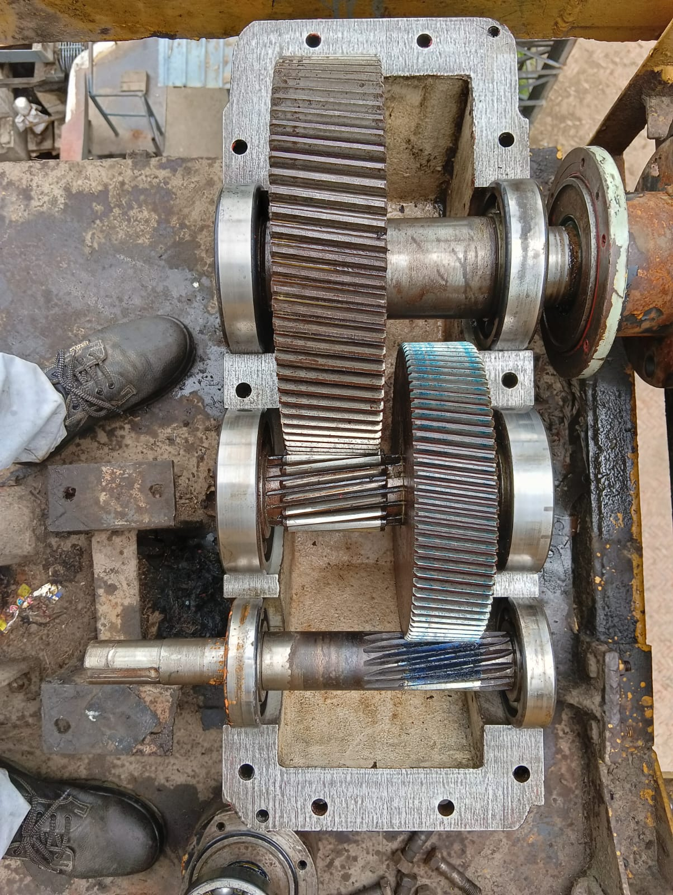
Capex Job
SBN 630 Gear Box for Mill No-1,2,3,& 4 Report (off Season 2025)
Observation Noted
Heavy pitting found output shaft at mill & turbine side bottom cover bearing seat for all mill FMG.
Minor pitting found of out put shaft top bearing cover bearing seat for all mill FMG
Minor pitting found at gear & Pinion teeth of output shaft for all mill FMG
Minor pitting on gear & Pinion Teeth 02 Nos out of 18 nos.
Minor Chip out on gear teeth 09 nos. out of 61 nos. teeth
Impression also found on bearing outer race. Bearing Rollers found OK. Present bearing 23064 b clearance 0.27 mm/0.35 mm(T/M)
Pitting found at mill side top cover bearing seat.
Gear teeth condition found okay (Minor Scratch

Slide 21
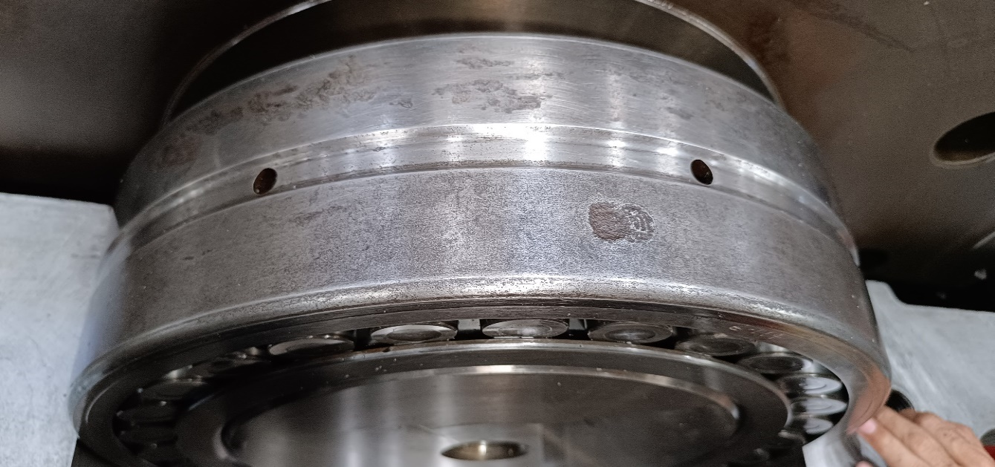
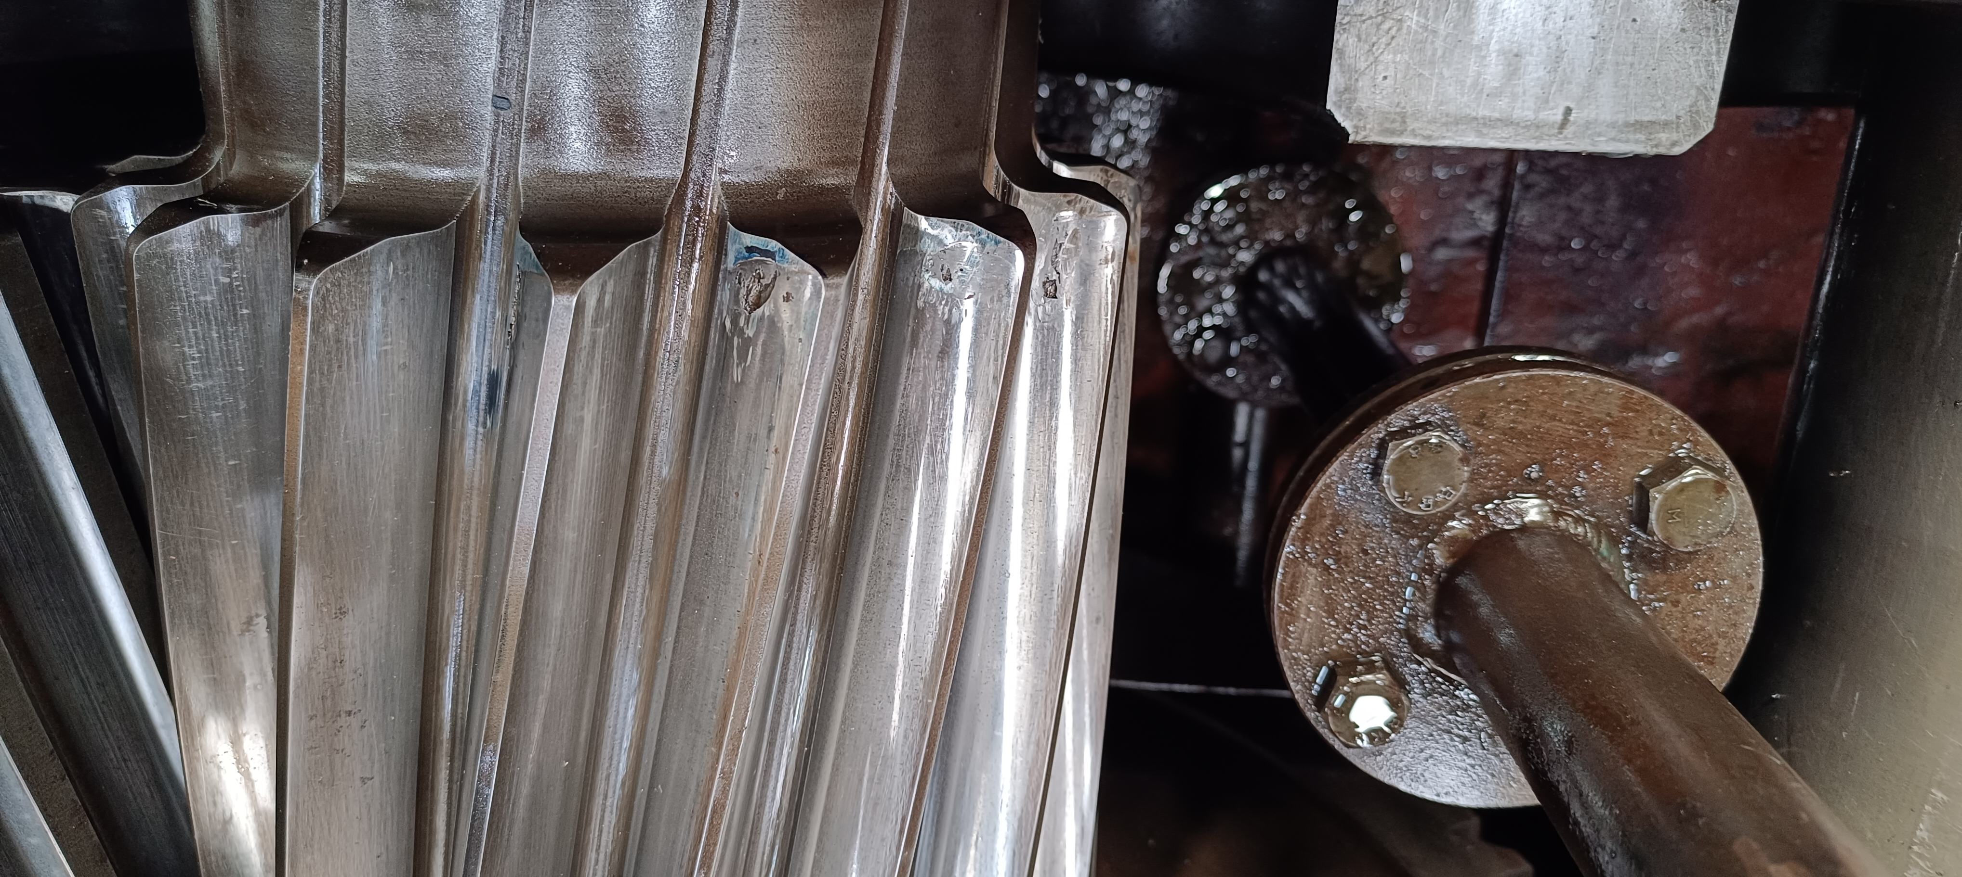
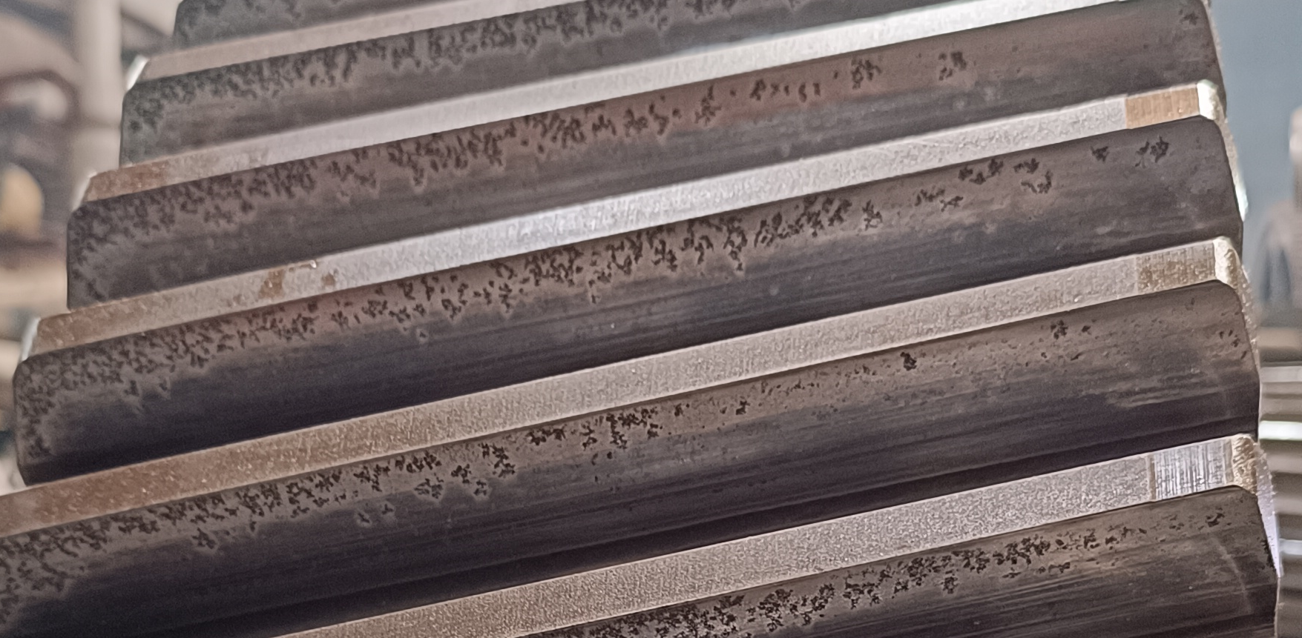
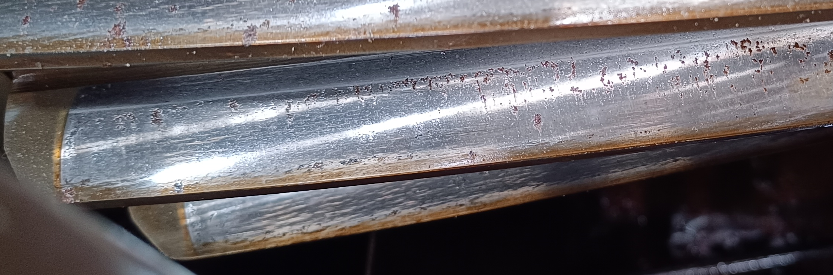
SBN 630 Gear Box for Mill No-1 & 2 Report (off season 2025 )
1st MILL OUTPUT SHAFT
Outer race impression & Bearing Roller minor pitting Found
Heavy pitting found at mill side & turbine side bottom bearing seat.
1ST MILL INTERMEDIATE SHAFT
Minor teeth chip out 9 Nos out of 18 teeth .
2ND MILL INTERMEDIATE GEAR SHAFT
Pitting found on pinion teeth 3Nos out of 18
2ND MILL INTERMEDIATE GEAR SHAFT
Pitting found on Gear teeth 13Nos out of 69 Teeth

Slide 22
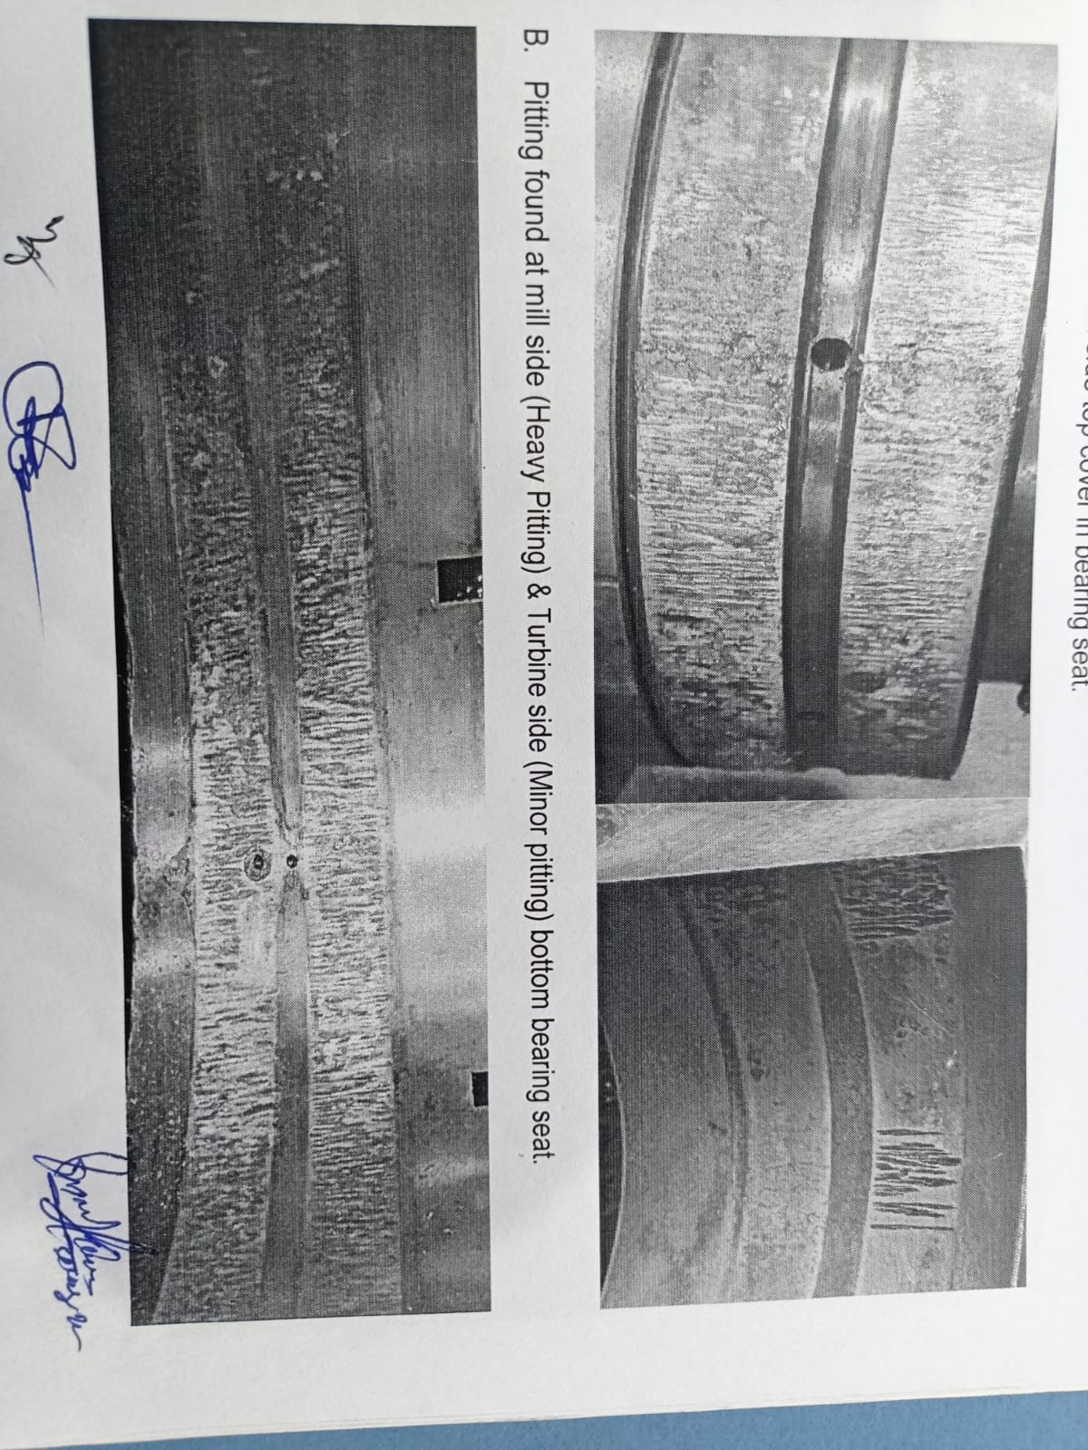
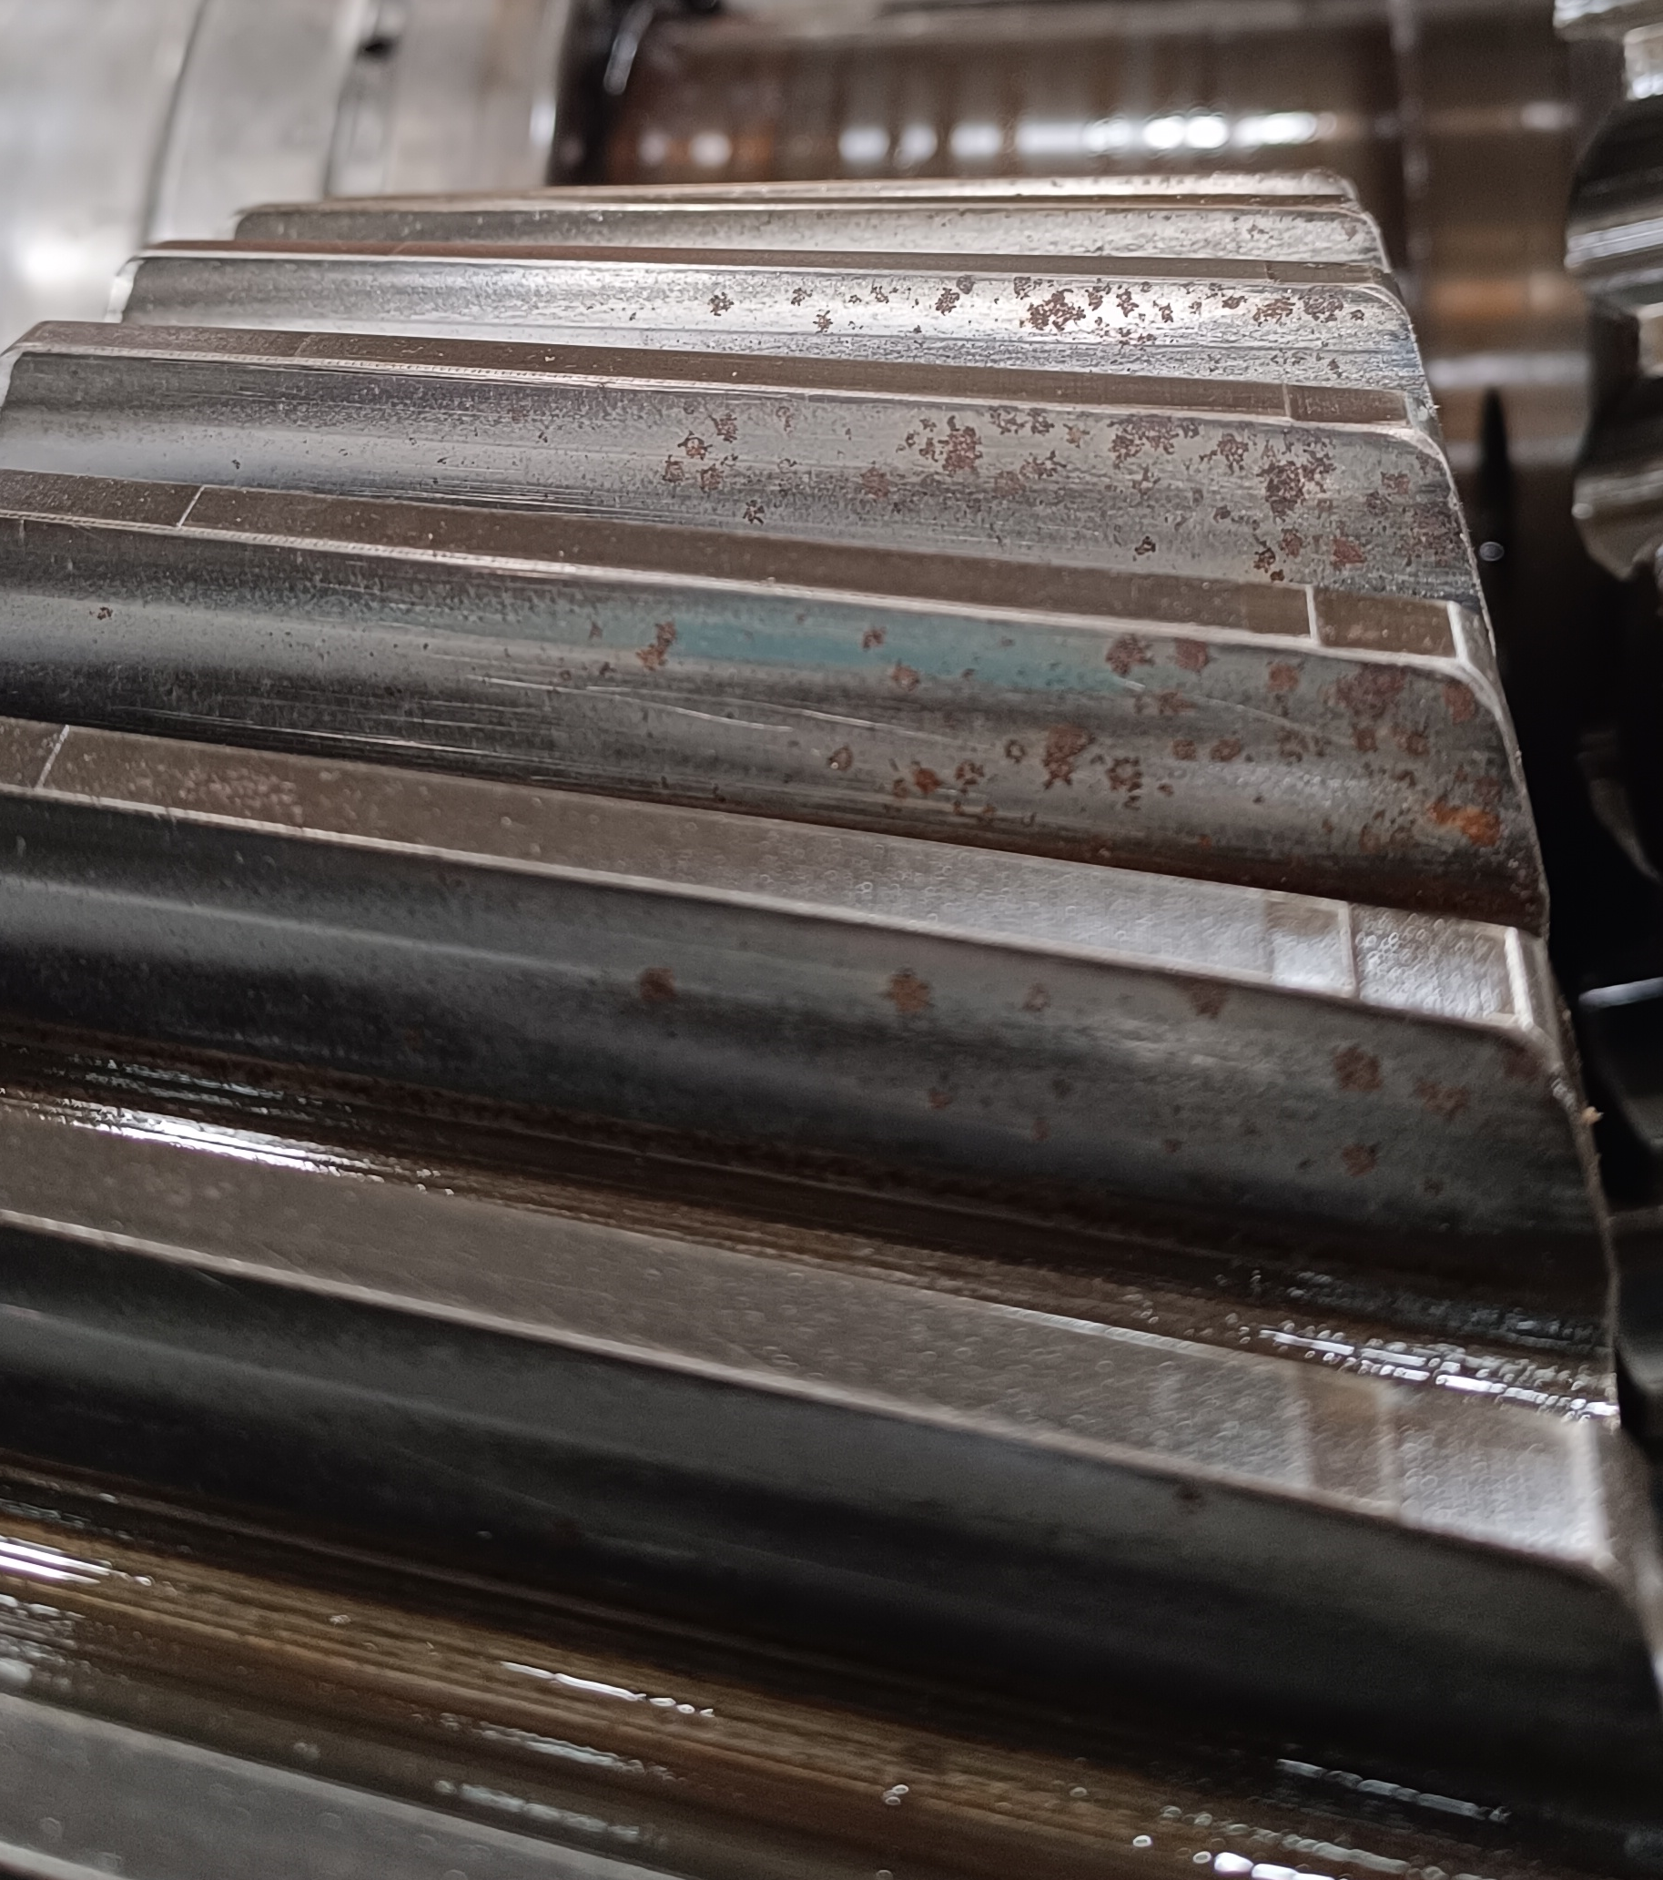
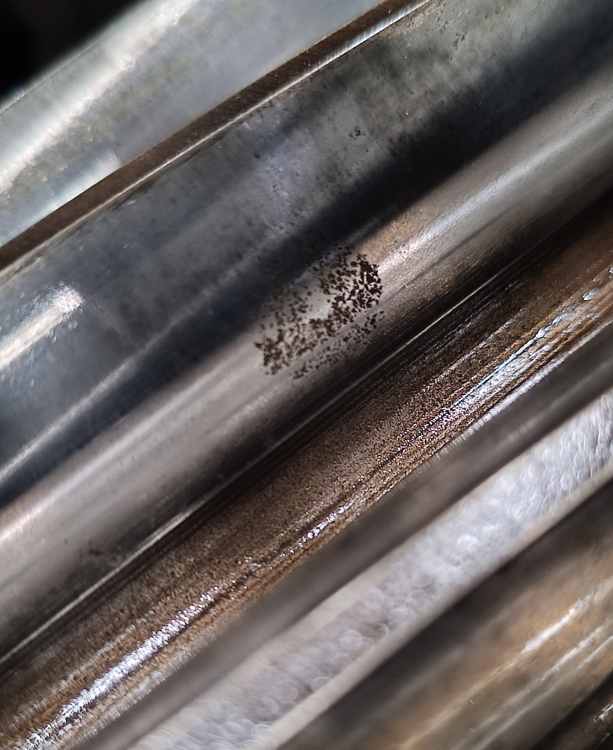
SBN 630 Gear Box for Mill No-3 Report (off season 2024 & 2025 )
3rd MILL OUTPUT SHAFT
Outer race impression & Bearing Roller minor pitting Found
Heavy pitting found at mill side & turbine side bottom bearing seat.
Inspection Report 2024 off Season
3rd MILL INTERMEDIATE GEAR SHAFT
Pitting found at gear teeth 9 out off 61 teeth.
Inspection Report 2025 off Season
3rd MILL INTERMEDIATE PINION SHAFT
Pitting found on pinion teeth 2Nos out of 18 Teeth.

Slide 23
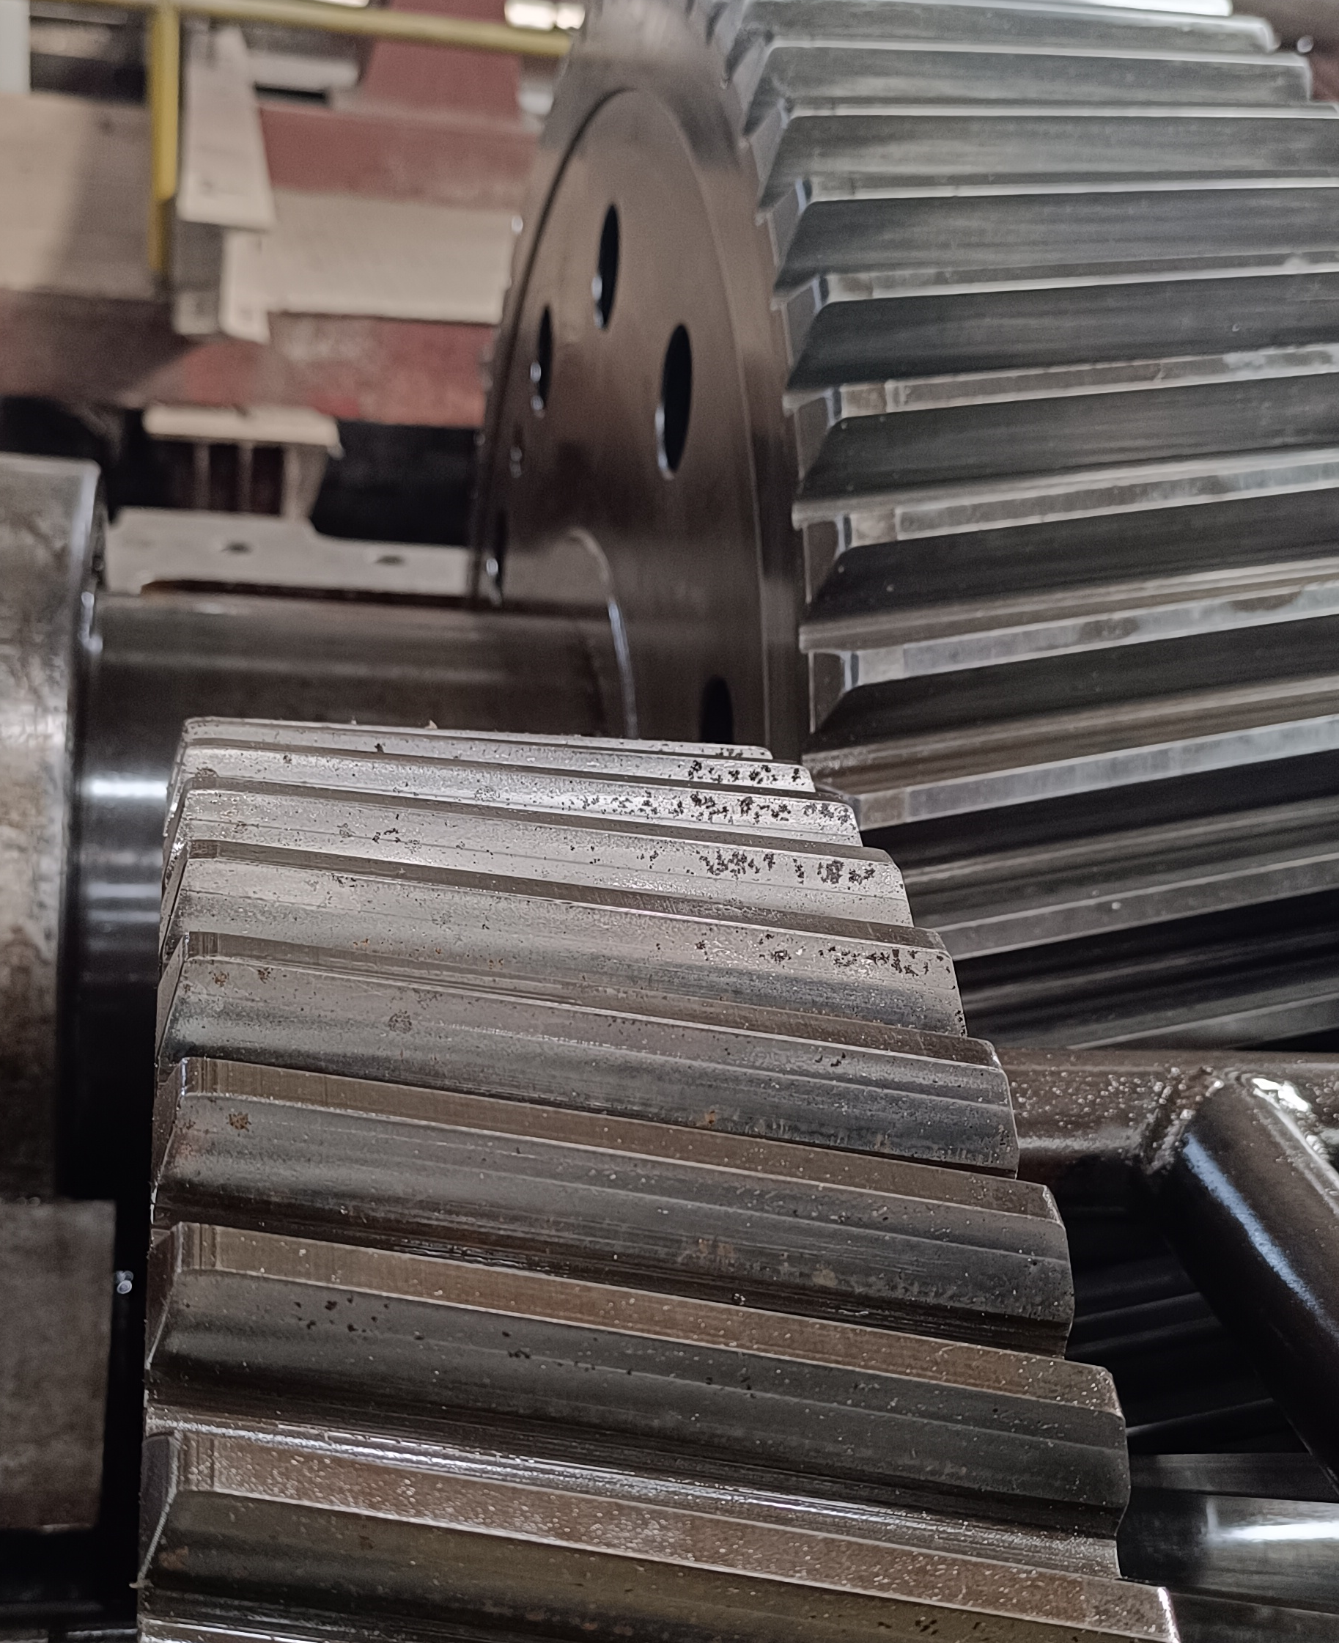
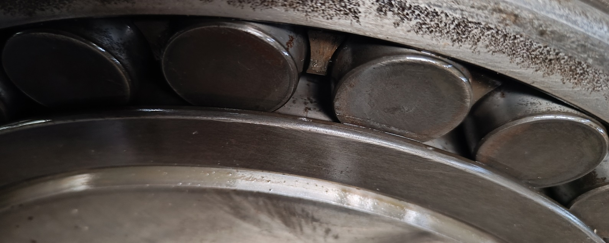
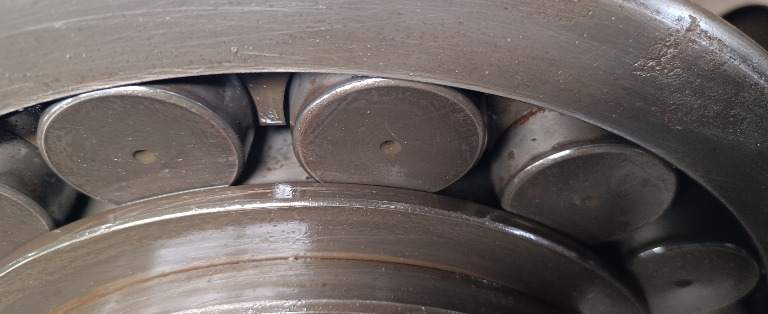
SBN 630 Gear Box for Mill No-4 Report (off season 2025)
4th MILL INTERMEDIATE GEAR SHAFT
Pitting found at gear teeth 16 out off 61 teeth.
4th output gear shaft
Outer race impression & Bearing Roller minor pitting Found
Heavy pitting found at mill side & turbine side bottom bearing seat.
4th MILL INTERMEDIATE PINION SHAFT
Pitting found on pinion teeth 4 Nos out of 18 Teeth.

Slide 24
SBN 630 Gear Box for Mill No-1,2,3,& 4 Overhauling Report off season 2023 to 2025
Sr. No. | Item Description | Observation O/S 2025 | Observation O/S 2024 | Observation O/S 2023 | Remark
1 | MILL NO. 1 FMG GEAR BOX (SBN-630) Sr.No.WHG16569LH
A | Input pinion
i | Input pinion Bearing Seat ,Top Cover Seat & pinion teeth | Minor pitting | Minor pitting | Minor pitting
B | Intermediate Gear
i | Intermediate pinion | Minor pitting / chip out 9 teeth out of 18 | Minor pitting | Minor pitting | Increase to last year
C | Output Gear
i | Output gear bearing seat in top cover DE | Minor pitting | Minor pitting | Minor pitting
ii | Output gear bearing seat in bottom cover DE | Heavy pitting | Heavy pitting | Heavy pitting
ii | Output gear bearing seat in top cover NDE | Minor pitting | Minor pitting | Minor pitting
iv | Output gear bearing seat in bottom cover NDE | Heavy pitting | Heavy pitting | Heavy pitting
v | Output gear teeth | Minor pitting / Scratch | Minor pitting / Scratch | Minor pitting / Scratch
2 | MILL NO. 2 FMG GEAR BOX (SBN-630) Sr.No.WHG16559LH
A | Input pinion
i | Input pinion Bearing Seat ,Top Cover Seat & pinion teeth | Minor pitting Starting stage | Minor pitting Starting stage | Minor pitting Starting stage
B | Intermediate Gear
i | Intermediate pinion | Minor pitting out 3 teeth out of 18 Starting stage | Minor pitting | Minor pitting out Starting stage | Increase to last year
C | Output Gear
i | Output gear bearing seat in top cover DE | Minor pitting | Minor pitting | Minor pitting
ii | Output gear bearing seat in bottom cover DE | Heavy pitting | Heavy pitting | Heavy pitting
ii | Output gear bearing seat in top cover NDE | Minor pitting | Minor pitting | Minor pitting
iv | Output gear bearing seat in bottom cover NDE | Heavy pitting | Heavy pitting | Heavy pitting
v | Output gear teeth | Minor pitting / chip out 13 teeth out of 69 | Minor pitting Starting stage | Minor pitting Starting stage | Increase to last year

Slide 25
SBN 630 Gear Box for Mill No-1,2,3,& 4 Overhauling Report off season 2023 to 2025
Sr. No. | Item Description | Observation O/S 2025 | Observation O/F 2024 | Observation O/F 2023 | Remark
3 | MILL NO. 3 FMG GEAR BOX (SBN-630) Sr.No.WHG16422 LH Make
A | Input pinion
i | Input pinion gear teeth | Minor pitting | Minor pitting | Minor pitting
B | Intermediate Gear
i | Intermediate gear teeth | Minor pitting / chip out 09 teeth out of 61 | Minor pitting | Minor pitting | Increase to last year
ii | Intermediate pinion | Minor pitting / chip out 02 teeth out of 18 | Minor Scratch | Minor Scratch | Increase to last year
C | Output Gear
i | Output gear bearing seat in top cover DE | Minor pitting | Minor pitting | Minor pitting
ii | Output gear bearing seat in bottom cover DE | Heavy pitting | Heavy pitting | Heavy pitting
ii | Output gear bearing seat in top cover NDE | Minor pitting | Minor pitting | Minor pitting
iv | Output gear bearing seat in bottom cover NDE | Heavy pitting | Heavy pitting | Heavy pitting
v | Output gear teeth | Minor Scratch/ pitting | Minor Scratch/ pitting | Minor Scratch/ pitting
4 | MILL NO. 4 FMG GEAR BOX (SBN-630) Sr.No.WHG16393 LH Make
A | Input pinion
i | Input pinion gear teeth | Minor pitting | Minor pitting | Minor pitting
B | Intermediate Gear
i | Intermediate gear teeth | Minor pitting / chip out 16 teeth out of 61 | Minor pitting | Minor pitting | Increase to last year
ii | Intermediate pinion | Minor pitting / chip out 04 teeth out of 18 | Minor pitting | Minor pitting | Increase to last year
C | Output Gear
i | Output gear bearing seat in top cover DE | Pitting Found | Pitting Found | Minor pitting
ii | Output gear bearing seat in bottom cover DE | Heavy pitting | Heavy pitting | Minor pitting
ii | Output gear bearing seat in top cover NDE | pitting Found | pitting Found | Pitting Found
iv | Output gear bearing seat in bottom cover NDE | Heavy pitting | Heavy pitting | Heavy pitting
v | Output gear teeth | Minor Scratch | Minor Scratch | Pitting Found

Slide 26
COMPLETIVE PRICE LIST OF GEAR BOX SPARE AND NEW SBN-630
Sr. No | Description of Material | Unit | Total Qty. (Nos.) | Elecon Unit Ex- works Price In Rs. | Elann Drive | Remark
A | Service |  |  |  |  | Ref no. EECL/NZ/DL/0153 Date. 26.12.2025 Ref No. Elann Drive QUOTE # EDAPL/25-26/N451 Date 08-01-2026
1 | Charges for dismantle, inspection, testing and painting of existing Coupling at our works. Elecon Make Coupling Type & Size: SBN-630 Sr. No. 16393 | Nos | 1 | 5,00,000 | 1,00,000
2 | Rectification/Replacement of bearing seating area (per bearing seating area) | Nos | 1 | 50000 (One Side) | 2,75,000 (Both Side)
B | Item Description |  |  |  |  | Ref. No.: D04/NZ/G-2857/R1 Date: 16th December 2025
1 | Input Pinion (Part No. 102) suitable for Elecon Make Gearbox Type & Size: SBN-630, Ratio 14:1 as per existing Sr. No. WHG 16559 LH. (HSN Code: 84839000) | Nos | 1 | 12,05,710/- | 1,56,744
2 | 1 st Intermediate Wheel (Part No. 103) suitable for Elecon Make Gearbox Type & Size: SBN-630, Ratio 14:1 as per existing Sr. No. WHG 16559 LH. (HSN Code: 84839000) | Nos | 1 | 12,05,710/- | 2,88,428
3 | 1 st Intermediate Pinion (Part No. 302) suitable for Elecon Make Gearbox Type & Size: SBN-630, Ratio 14:1 as per existing Sr. No. WHG 16559 LH. (HSN Code: 84839000) | Nos | 1 | 13,02,170/- | 2,19,709
4 | Output Wheel (Part No. 303) suitable for Elecon Make Gearbox Type & Size: SBN-630, Ratio 14:1 as per existing Sr. No. WHG 16559 LH. (HSN Code: 84839000) | Nos | 1 | 12,05,710/- | 7,92,185

Slide 27
COMPLETIVE PRICE LIST OF GEAR BOX SPARE AND NEW SBN-630
Sr. No | Description of Material | Unit | Total Qty. (Nos.) | Elecon Unit Ex- works Price In Rs. | Elann Drive | Remark
5 | Output Shaft (Part No. 202) suitable for Elecon Make Gearbox Type & Size: SBN-630, Ratio 14:1 as per existing Sr. No. WHG 16559 LH. (HSN Code: 84839000) | Nos | 1 | 3,85,830/ | 3,20,585
6 | Elecon Make Gearbox Type & Size: SBN-630 with CI Casing & Internal Piping but, without Force Lubrication System (FLS) & any other Accessories, Ratio 14:1 as per existing Sr. No. WHG 16559 LH.(HSN Code: 84834000) | Nos | 1 | 65,10,850/- | 34,00,000 | Ref. No.: D04/NZ/G-2857 Date: 27th November 2025
7 | Complete Set of Internals without Gear Casing, Bearings, Oil Seals, All C-Class Items & any other Accessories suitable for Elecon Make Gearbox Type & Size: SBN-630, Ratio 14:1 as per existing Sr. No. WHG 16559 LH. (HSN Code: 84839000) | Nos | 1 | 53,05,140/- | 17,77,651
8 | Complete fabricated Housing of Gearbox | Nos | 1 | NA | 11,92,515
Terms & Conditions:
 | Price Basis: |  |  | Ex-Works Vallabh Vidhyanagar
 | Packing & Forwarding: |  |  | 3% | 3%
 | GST: |  |  | 18% | 18%
 | TDS: |  |  | 0.1% >10 Cr.
 | Payment Term: |  |  | 30%Adv+GST | 50% Advance and balance against PI Prior to dispatch
 | Delivery: |  |  | 5-6 Months | 2-3 Month
 | Guarantee / Warranty: |  |  | 18 Month Supply/12 Month Insallation | 12 Month Installation

Slide 28
SBN 630 Gear Box for Mill No-1,2,3,& 4 Spare part offer By OEM
Total Rs 53,05,130

Slide 29
SBN 630 Gear Box for Mill No-1,2,3,& 4 Spare part Servicing offer By OEM

Slide 30
New FMG offer for SBN 630 by OEM

Slide 31
LONG DELEVERY ITEM REQUIRED FOR OFF SEASON 2026
Sl.NO | ITEM DECRIPTION | UOM | Rate /unit | Ins Qty | OFF SEASON |  |  |  | Stock |  | Net Req. | Total value Rs | Remark
 |  |  |  |  | 2026 | 2025 | 2024 | 2023 | Store | Mill
1 | Deshelling/Re-shelling Of Mill Roller Shell Top Roller KCP | Nos | 8.6 | 2 | 1 | 1 | 1 | 1 |  |  | 1 | 8.6
2 | Deshelling/Re-shelling Of Mill Roller Shell Bottom Roller KCP | Nos | 8.6 | 2 | 1 | 1 | 1 | 0 |  |  | 1 | 8.6
3 | Deshelling/Re-shelling Of Mill Top Roller Shell 50.8 Mm Pitch | Nos. | 8.6 | 3 | 1 | 2 | 1 | 2 |  |  | 1 | 8.6
4 | Deshelling/Re-shelling Of Mill Disch. Roller Shell 50.8 Mm | Nos | 7.35 | 3 | 1 | 2 | 2 | 1 |  |  | 1 | 7.35
5 | Deshelling/Re-shelling Of Mill Feed Roller Shell 50.8 Mm | Nos | 6.3 | 3 | 2 | 0 | 1 | 2 |  |  | 2 | 12.6
6 | Deshelling/Re-shelling Of TUFR Roller Shell Of Mill No 3 | Nos | 12 | 3 | 1 | 2 | 0 | 0 |  |  | 1 | 12 | Shell thick worn out and tooth thick & height decrease
7 | Deshelling/Re-shelling Of Under Feed Roller Zero Mill | Nos | 10.5 | 2 | 1 | 0 | 0 | 0 |  |  | 1 | 10.5 | Roller dia&length less of under feed roller
8 | Trash Plate For Taxmaco Mill | Nos. | 1.28 | 3 | 1 | 0 | 0 | 2 |  | 0 | 1 | 1.28
9 | Trash Beam For Taxmaco Mill | Nos. | 4.03 | 3 | 2 | 1 | 0 | 0 |  |  | 2 | 8.06 | due to more worn-out & less thickness
10 | Bearing Bracket For Trash Beam | Nos. | 0.355 | 6 | 4 | 2 | 0 | 0 |  |  | 4 | 1.42 | due to more worn-out & less thickness

Slide 32
LONG DELEVERY ITEM REQUIRED FOR OFF SEASON 2026
Sl.NO | ITEM DECRIPTION | UOM | Rate /unit | Ins Qty | OFF SEASON |  |  |  | Stock |  | Net Req. | Total value | Remark
 |  |  |  |  | 2026 | 2025 | 2024 | 2023 | Store | Mill
11 | TRASH BEAM BOLT WITH SS NUT FOR TAXMACO MILL. | NOS. | 0.06 | 36 | 24 | 12 | 0 | 12 |  |  | 24 | 1.44
12 | TOP SCRAPER BRACKET FOR TEXMACO MILL | NOS. | 0.135 | 6 | 2 | 4 | 0 | 0 |  |  | 2 | 0.27 | due to more wornout & less thickness
13 | DISCHARGE SCRAPER BRACKET FOR TEXMACO MILL | NOS. | 0.135 | 6 | 6 | 0 | 0 | 0 |  |  | 6 | 0.81 | due to more wornout & less thickness
14 | C. S. SCRAPPER FOR TOP ROLLER DRG-TM-GEN-12/07 WITH GROOVING | NOS. | 0.679 | 3 | 6 | 6 | 5 | 3 |  | 0 | 6 | 4.074
15 | C.S. SCRAPPER FOR DISCHARGE ROLLER DRG-TM-GEN-12/07 WITH | NOS. | 0.711 | 3 | 3 | 3 | 4 | 3 |  | 0 | 3 | 2.133
16 | TOP SCRAPER FOR KCP MILL AS PER DRG. NO M-KCP-40-19 | NOS. | 1.02 | 2 | 2 | 1 | 1 | 2 |  | 0 | 2 | 2.04
17 | BOTTOM SCRAPER FOR KCP MILL AS PER DRG. NO. M-KCP-41-19 | NOS. | 1.02 | 2 | 2 | 1 | 1 | 2 |  | 0 | 2 | 2.04
18 | HOLDER FOR TOP SCRAPER OF KCP MILL APD | NOS | 1.5 | 2 | 1 | 0 | 0 | 0 |  |  | 1 | 1.5
19 | HOLDER FOR BOTOM SCRAPER OF KCP MILL APD | NOS | 1.5 | 2 | 1 | 0 | 0 | 0 |  |  | 1 | 1.5
20 | MILL ROLLER SHAFT,596 MM DIAX 4925 MM LONG | NOS. | 19.58 | 9 | 1 | 1 | 1 | 1 |  |  | 1 | 19.58 | In Capex

Slide 33
LONG DELEVERY ITEM REQUIRED FOR OFF SEASON 2026
Sl.NO | ITEM DECRIPTION | UOM | Rate /unit | Ins Qty | OFF SEASON |  |  |  | Stock |  | Net Req. | Total value | Remark
 |  |  |  |  | 2026 | 2025 | 2024 | 2023 | Store | Mill
21 | INLINE SHREDDER HAMMER WITHOUTBUSH,DRG NO M-KCP-47-20 | NOS. | 0.103 | 136 | 280 | 280 | 276 | 414 |  |  | 280 | 28.84
22 | INLINE SHREDDER HAMMER WITHOUTBUSH,DRG NO M-KCP-48-20 | NOS. | 0.103 | 36 | 82 | 82 | 78 | 114 |  |  | 82 | 8.446
23 | INLINE SHREDDER HAMMER PIN,DRG NO M-KCP-11-16 | NOS | 0.463 | 8 | 8 | 8 | 8 | 8 |  |  | 8 | 3.704
24 | Pivot plate for Shredder APD | NOS | 10 | 1 | 1 | 0 | 0 | 0 |  |  | 1 | 10 | due to more wornout & less thickness
25 | SHREDDER DOMITE HAMMER TIP,80X56 MM,WITH HT BOLT & WASHER | NOS. | 0.016 | 172 | 720 | 720 | 547 | 720 |  |  | 720 | 11.52
26 | 300 MM PITCH CHAIN FORGED BLOCK TYPE,DRG NO.- TM-CHN-RC-2/06 | MTR | 0.167 | 138 | 45 | 45 | 45 | 45 |  |  | 45 | 7.515
27 | 229 MM PITCH DROP FORGED LINK CHAIN,AS DRG TM-CHN-IC-03/06 | MTR | 0.072 | 143 | 50 | 50 | 50 | 50 |  |  | 50 | 3.6
28 | BUSH FOR 300 MM PITCH CHAIN AS PER DRG TM CHN-RC-02/06 | NOS. | 0.0027 | 462 | 0 | 0 | 0 | 0 |  | 0 | 0 | 0
29 | LINK WITH ATTACHMENT FOR 300 MM PITCH DROP FORGED LIN CHAIN | NOS. | 0.0348 | 154 | 40 | 40 | 40 | 30 |  | 0 | 40 | 1.392
30 | PIN WITH NYLOC NUT FOR 300 MM PITCH LINK CHAIN, | NOS. | 0.0087 | 462 | 200 | 200 | 140 | 200 |  | 0 | 200 | 1.74

Slide 34
LONG DELEVERY ITEM REQUIRED FOR OFF SEASON 2026
Sl.NO | ITEM DECRIPTION | UOM | Rate /unit | Ins Qty | OFF SEASON |  |  |  | Stock |  | Net Req. | Total value | Remark
 |  |  |  |  | 2026 | 2025 | 2024 | 2023 | Store | Mill
31 | LINK WITHOUT ATTACHMENT FOR 300 MM PITCH DROP FORGED LINK CH | NOS. | 0.03 | 308 | 50 | 50 | 50 | 0 |  | 0 | 50 | 1.5
32 | BUSH FOR 229 MM PITCH DROP FORGE LINK CHAIN AS PER DRG. NO.- | NOS. | 0.0012 | 600 | 0 | 0 | 0 | 0 |  | 0 | 0 | 0
33 | PIN WITH NYLOC NUT FOR 229 MM PITCH DROP FORGED LINK CHAIN, | NOS. | 0.0028 | 600 | 300 | 200 | 300 | 200 |  | 0 | 300 | 0.84
34 | LINK WITH ATTACHMENT FOR 229MM PITCH DROP FORGED LINCHAIN | NOS. | 0.02 | 150 | 50 | 50 | 20 | 50 |  | 0 | 50 | 1
35 | LINK WITHOUT ATTACHMENT FOR 229 MM PITCH | NOS. | 0.015 | 450 | 100 | 100 | 40 | 50 |  | 0 | 100 | 1.5
36 | CHAIN ASSBLY FOR CANE CARRIER 200 MM PITCH | MTR | 0.115 | 784 | 520 | 0 | 520 | 0 |  |  | 520 | 59.8
37 | PIN FOR CANE CARRIER CHAIN 200 MM PITCH ITEM NO-4 | NOS | 0.0025 | 2600 | 650 | 2600 | 650 | 3000 |  | 0 | 650 | 1.625
38 | BUSH FOR CANE CARRIER CHAIN 200 MM PITCH ITEM NO-5 | NOS | 0.0011 | 2600 | 1000 | 2600 | 1000 | 3200 |  | 0 | 1000 | 1.1
39 | ROLLER FOR CANE CARRIER CHAIN 200 MM PITCH ITEM NO-6 | NOS | 0.0027 | 2600 | 600 | 2600 | 600 | 3000 |  | 0 | 600 | 1.62
40 | CASTLE NUT FOR CANE CARRIER CHAIN 200 MM PITCH ITEM NO-7 | NOS | 0.00034 | 2600 | 500 | 500 | 0 | 500 |  |  | 500 | 0.17

Slide 35
LONG DELEVERY ITEM REQUIRED FOR OFF SEASON 2026
Sl.NO | ITEM DECRIPTION | UOM | Rate /unit | Ins Qty | OFF SEASON |  |  |  | Stock |  | Net Req. | Total value | Remark
 |  |  |  |  | 2026 | 2025 | 2024 | 2023 | Store | Mill
41 | OUTER LINK ITEM NO-2 FOR CANE CARRIER CHAIN 200 MM PITCH (Sloted) | NOS | 0.008 | 1300 | 350 | 350 | 0 | 350 |  | 0 | 350 | 2.8
42 | OUTER LINK ITEM NO-3 FOR CANE CARRIER CHAIN 200 MM PITCH(Round) | NOS | 0.008 | 1300 | 350 | 350 | 0 | 350 |  | 0 | 350 | 2.8
43 | INNER LINK ITEM NO-1 FOR CANE CARRIER CHAIN 200 MM PITCH | NOS | 0.008 | 2600 | 700 | 700 | 0 | 700 |  | 0 | 700 | 5.6
44 | SLATES M.S.FOR CANE CARRIER CHAIN 200 MM PITCH | NOS | 0.039 | 980 | 300 | 250 | 250 | 250 |  | 0 | 300 | 11.7
45 | FORGED STEEL INTERMDIATE SHAFT FOR MILL TRANSMISSION GEAR | NO. | 5.5 | 4 | 1 | 0 | 1 | 0 |  |  | 1 | 5.5
46 | G.M. LINER FOR KCP MILL (BOTTOM ROLLER),Drg No : M-KCP-14-16 ,MOC LTB 1 with test certificate on Conversion Basis ,Appx Wts :550 Kg / Each | Nos | 1.25 | 4 | 2 | 2 | 2 |  |  | 0 | 2 | 2.5
47 | G.M. LINER Top Roller Top half FOR KCP MILL(TOP ROLLER),Drg No: M-KCP-45-20 ,MOC: LTB1 with test certificate on Conversion Basis,Appx Wts:360 Kg / Each | Nos | 0.8 | 4 | 2 | 2 | 2 |  |  | 0 | 2 | 1.6
48 | G.M. LINER Top Roller Bottom half FOR KCP MILL(TOP ROLLER),Drg No: M-KCP-46-20 MOC: LTB1 with test certificate on Conversion Basis,Appx Wts :242 Kg / Each | Nos | 0.5 | 4 | 2 | 2 | 2 |  |  | 0 | 2 | 1
49 | G.M. LINER Top Roller top half & Bottom Roller bottom half FOR TEXMACO MILL Drg No: TM-GEN-07-07,MOC: LTB1 with test certificate on Conversion Basis,Appx Wts:130 Kg/Each | Nos | 0.28 | 24 | 4 | 4 | 4 |  |  | 0 | 4 | 1.12
50 | HOIST DRUM FOR CANE UNLOADER APD | NOS | 1.5 | 6 | 3 | 1 | 0 | 0

Slide 36
LONG DELEVERY ITEM REQUIRED FOR OFF SEASON 2026
Sl.NO | ITEM DECRIPTION | UOM | Rate /unit | Ins Qty | OFF SEASON |  |  |  | Stock |  | Net Req. | Total value | Remark
 |  |  |  |  | 2026 | 2025 | 2024 | 2023 | Store | Mill
51 | BEARING HOUSING BOTTOM HALF OFSIDE ROLLER FOR TEXMACO MILL | NOS | 1.38 | 24 | 4 | 0 | 4 | 0 |  |  | 4 | 5.52
52 | PROOF MACHINE FORGED STEEL,SHAFT SIZE 460MM DIAX2080L(T.Gear) | NOS | 5.5 | 4 | 1 | 1 | 1 | 1 |  |  | 1 | 5.5
53 | NEW PINION SHAFT FOR,TRANSMISSION GEAR OF MILL | NOS | 3.66 | 4 | 1 | 0 | 1 | 1 |  |  | 1 | 3.66
54 | IMPACT IDLER WITH SYNTHETIC,RUBBER AS DRG NO M-KCP-35-21 | NOS. | 0.11 | 5 | 5 | 0 | 0 | 0 |  |  | 5 | 0.55
55 | ANTI MAGNETIC IDLER (SS 304) SIZE 141MM DIA X 2400MM LONG | NOS. | 0.2 | 7 | 7 | 0 | 0 | 0 |  |  | 7 | 1.4
56 | DOUBLE ROW SPHERICAL ROLLER BEARING 239 / 560 BK.MB C3/W33 | NO | 4.76 | 4 | 1 | 1 | 1 | 1 |  |  | 1 | 4.76
57 | GEAR COUPLING GC-114 ,MAKE-NU-TECK | NO. | 4.4 |  | 1 | 0 | 0 | 1 |  |  | 1 | 4.4
58 | GEAR COUPLING GC-D-2008-C | NO. | 0.68 |  |  | 0 | 0 | 1 |  |  | 0 | 0
59 | SPACER TYPE GEAR COUPLING GC-110 ,MAKE-NU-TECK for Shredder APD | NO | 2.5 | 2 | 2 | 0 | 0 | 2 |  |  | 2 | 5
60 | REPLACEMENT OF HEAD STOCK MILL NO.1 |  |  |  |  |  |  |  |  |  | 0 | 0

Slide 37
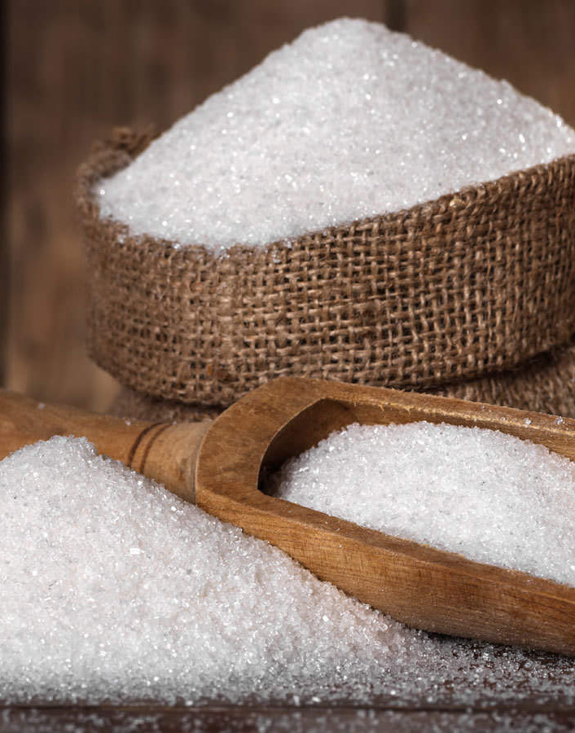
PRODUCTION

Slide 38
General Observation
The R3 massecuite boiling system and Mud removal system has been taken into operation and is running satisfactorily in all respects.
Syrup diversion process validation fee has been deposited and NSI team visit is awaited for the same.

Slide 39
Weekly Performance Snapshot - Production
No. | Capacity Utilization | Target | Current Week | Last Week | Till Date
1 | Sugar Production (LQ) | 15.26 | 0.64 | 0.63 | 7.02
2 | Sugar Bagging – RS (Qtl) | 824250 | 37342 | 36754 | 428452
3 | Sugar Bagging – DS (Qtl) | 702139 | 26024 | 25839 | 273309
 | Recovery
4 | Sugar Recovery CH – RS (%) | 10.14
5 | Sugar Recovery CH – DS (%) | 10.14
6 | Sugar Recovery BH – RS (%) | 10.69 | 9.93 | 9.69 | 9.81
7 | Sugar Recovery BH – DS (%) | 10.69 | 9.89 | 9.65 | 9.55
8 | B-Mol Recovery – RS (%) | 6.8 | 5.75 | 6.01 | 5.87
9 | B-Mol Recovery – DS (%) | 7.20 | 5.66 | 7.07 | 6.70
 | Quality
10 | B-Mol Purity – RS | < 51.00 | 50.24 | 50.39 | 50.31
11 | B-Mol Purity – DS | < 51.00 | 50.41 | 50.32 | 50.46
12 | Losses in Mol % Cane BH – RS | < 3.00 | 2.37 | 2.77 | 2.56
13 | Losses in Mol % Cane BH – DS | < 3.18 | 2.62 | 2.84 | 2.82
14 | Pol % Filter cake | < 2.00 | 1.7 | 1.9 | 1.7
 | Consumption
15 | Steam Consumption (Kg/Qtl Sugar) | 400 | 451 | 460 | 480
16 | Steam % Cane | <42 | 38.89 | 38.93 | 39.79
17 | Power Consumption (Units/Qtl Sugar) | 11 | 11.64 | 11.83 | 11.68
39

Slide 40
Weekly Sugar Production – DS House
Production Plan for Next Week
SKU | Quantity (Qtls) | % of Total
L | 0 | 0
M | 17388 | 90
S | 1932 | 10
Total | 19320 | 100

Slide 41
Weekly Sugar Production – RS House
Production Plan for Next Week
SKU | Quantity (Qtls) | % of Total
L | 3215 | 10
M | 22508 | 70
S | 4823 | 15
Pharma | 1607 | 5
Total | 32153 | 100
Icing | 5 | 0.32
Bura | 110 | 7.21
Sachet | 140 | 9.18
1kg pack | 400 | 26.22
5kg pack | 200 | 13.11
Superfine | 70 | 4.5
Brown 1kg | 100 | 6.5
Pharma | 500 | 32.77
Total | 1525 | 100%

Slide 42
Sugar Production Quality
Sugar Quality | Season 2025-26 |  |  |  | Season 2024-25
 | Target | Current Week | Last Week | Till Date | Week | Till Date
Sugar Quality - DS
ICUMSA (L-sugar) | <110
ICUMSA (M-sugar) |  | 74 | 79 | 100 | 103 | 118
ICUMSA (S-sugar) |  | 75 | 80 | 101 | 104 | 118
Sugar Quality – RS
ICUMSA (L-sugar) | <30 | 23 | 26 | 32 | 36 | 35
ICUMSA (M-sugar) |  | 24 | 27 | 32 | 37 | 35
ICUMSA (S-sugar) |  | 25 | 29 | 33 | 36 | 37
Sugar Quality Pharma
ICUMSA (SS - Sugar) | <25 | 23 | 28 | 31
ICUMSA (20/80 - Sugar) |  | 22 | 27 | 30 | 32 | 31
ICUMSA (30/80 - Sugar) |  | 23 | 27 | 30 | 34 | 33

Slide 43
Monthly Performance Snapshot - Production
S.No. | Capacity Utilization | Target | Dec.-25 | Dec.-24 | Nov.-25 | Nov.-24
1 | Sugar Production (LQ) | 15.26 | 2.89 | 2.77 | 2.62 | 2.12
2 | Sugar Bagging – RS (Qtl) | 824250 | 173434 | 169441 | 166302 | 120188
3 | Sugar Bagging – DS (Qtl) | 702139 | 115599 | 108046 | 95920 | 91961
 | Recovery
4 | Sugar Recovery CH – RS (%) | 10.14 | 11.03 | 10.75 | 9.39 | 9.28
5 | Sugar Recovery CH– DS (%) | 10.14 | 10.63(01 Dec. to 08 Dec.) | 10.45(01 Dec. to 21 Dec.) | 9.40 | 9.13
 | Sugar Recovery BH – RS (%) | 10.69
 | Sugar Recovery BH– DS (%) | 10.69 | 9.43(9 Dec. to 31 Dec.) | 9.45(22 Dec. to 31 Dec.)
6 | C-Mol Recovery – RS (%) | 4.8 | 4.34 | 4.77 | 4.41 | 4.65
7 | C-Mol Recovery – DS (%) | 5.2 | 5.12(01 Dec. to 08 Dec.) | 4.98(01 Dec. to 21 Dec.) | 3.86 | 4.62
8 | B-Mol Recovery – RS (%) | 6.8
9 | B-Mol Recovery – DS (%) | 7.2 | 6.96(9 Dec. to 31 Dec.) | 7.45(22 Dec. to 31 Dec.)
 | Quality
10 | C-Mol Purity – RS | <33.00 | 32.08 | 30.80 | 31.21 | 32.23
11 | C-Mol Purity – DS | <32.00 | 30.31(01 Dec. to 08 Dec.) | 30.68(01 Dec. to 21 Dec.) | 30.07 | 31.86
12 | B-Mol Purity – RS | <51.00
13 | B-Mol Purity – DS | <51.00 | 50.52(09 Dec. to 31 Dec.) | 51.10(22 Dec. to 31 Dec.)
14 | Losses in Mol % Cane CH– RS | <1.39 | 1.15 | 1.30 | 1.20 | 1.40
15 | Losses in Mol % Cane CH – DS | <1.46 | 1.18(01 Dec. to 08 Dec.) | 1.30(01 Dec. to 21 Dec.) | 1.23 | 1.41
16 | Losses in Mol % Cane BH – RS | <3.00
17 | Losses in Mol % Cane BH – DS | <3.18 | 2.86(09 Dec. to 31 Dec.) | 3.23(22 Dec. to 31 Dec.)
18 | Pol % Filter Cake | <2.00 | 1.95 | 1.96 | 2.05 | 1.95
 | Consumption
19 | Steam Consumption (Kg/Qtl Sugar) | 400 | 449 | 457.50 | 532 | 580
20 | Steam % Cane | 42 | 39.89 | 41.35 | 40.09 | 40.83
21 | Power Consumption (Units/Qtl Sugar) | 11 | 11.85 | 12.05 | 13.03 | 12.91

Slide 44
Steam consumption target Vs actual at different process
At Recovery % | Process option - 1 |  |  | Process option - 2 |  |  | Process option - 3
 | RS & DS on C-heavy with 125 KLD Distillery on Syrup |  |  | Both process on B-heavy with 125 KLD Distillery on Syrup |  |  | Both process on B-heavy
 | Target | Week actual | Actual till date | Target | Week actual | Till date | Target | Week actual | Actual Till date
10.50 | 42.00 |  |  | 40.00 | 38.89 | 39.79 | 41.00 | 38.93 | 39.88

Slide 45
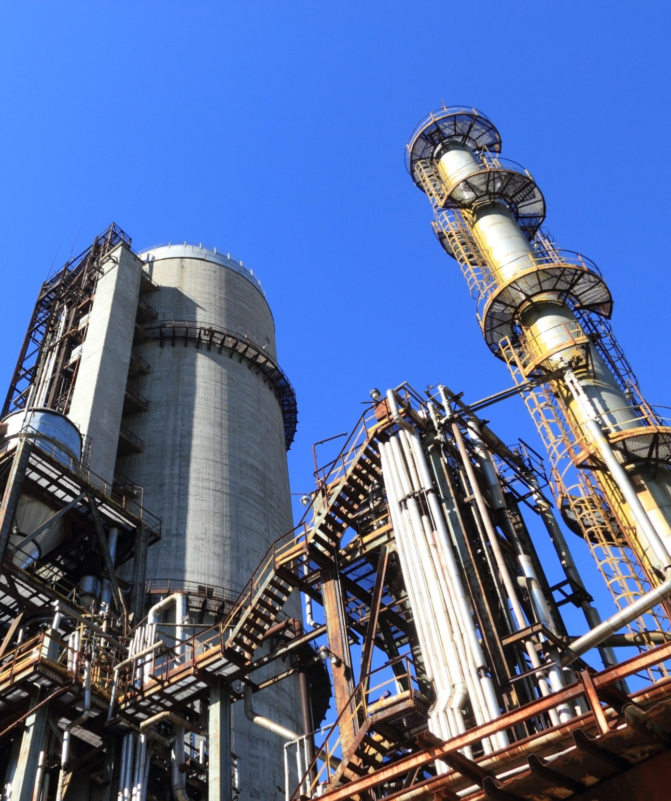
POWER PLANT

Slide 46
HIGHLIGHTS FOR THE WEEK
30.85 MW Power Plant The 30.85 MW Co-generation Plant is operating satisfactorily. All parameters of the 150 TPH Boiler and 30.85 MW Turbine were observed to be within normal limits during full-load operation. Avg. Steam Flow :150.3 TPH & Avg. TG load 29.40 MW. 70 TPH Boiler The 70 TPH boiler performed satisfactorily. Avg. Steam Flow :70.2 TPH. 4.0 MW Distillery Power Plant The 4.0 MW Distillery Co-generation Plant is running satisfactorily. Avg steam load 33.2 TPH and Avg power load 3.94 MW with the slop consumption of 2.30 TPH. Remarks – During this week, a grid failure of 40 minutes occurred due to tripping of the 132 kV ZIL transmission line from Dhaurahara Substation owing to bad weather conditions. Line patrolling is in progress.

Slide 47
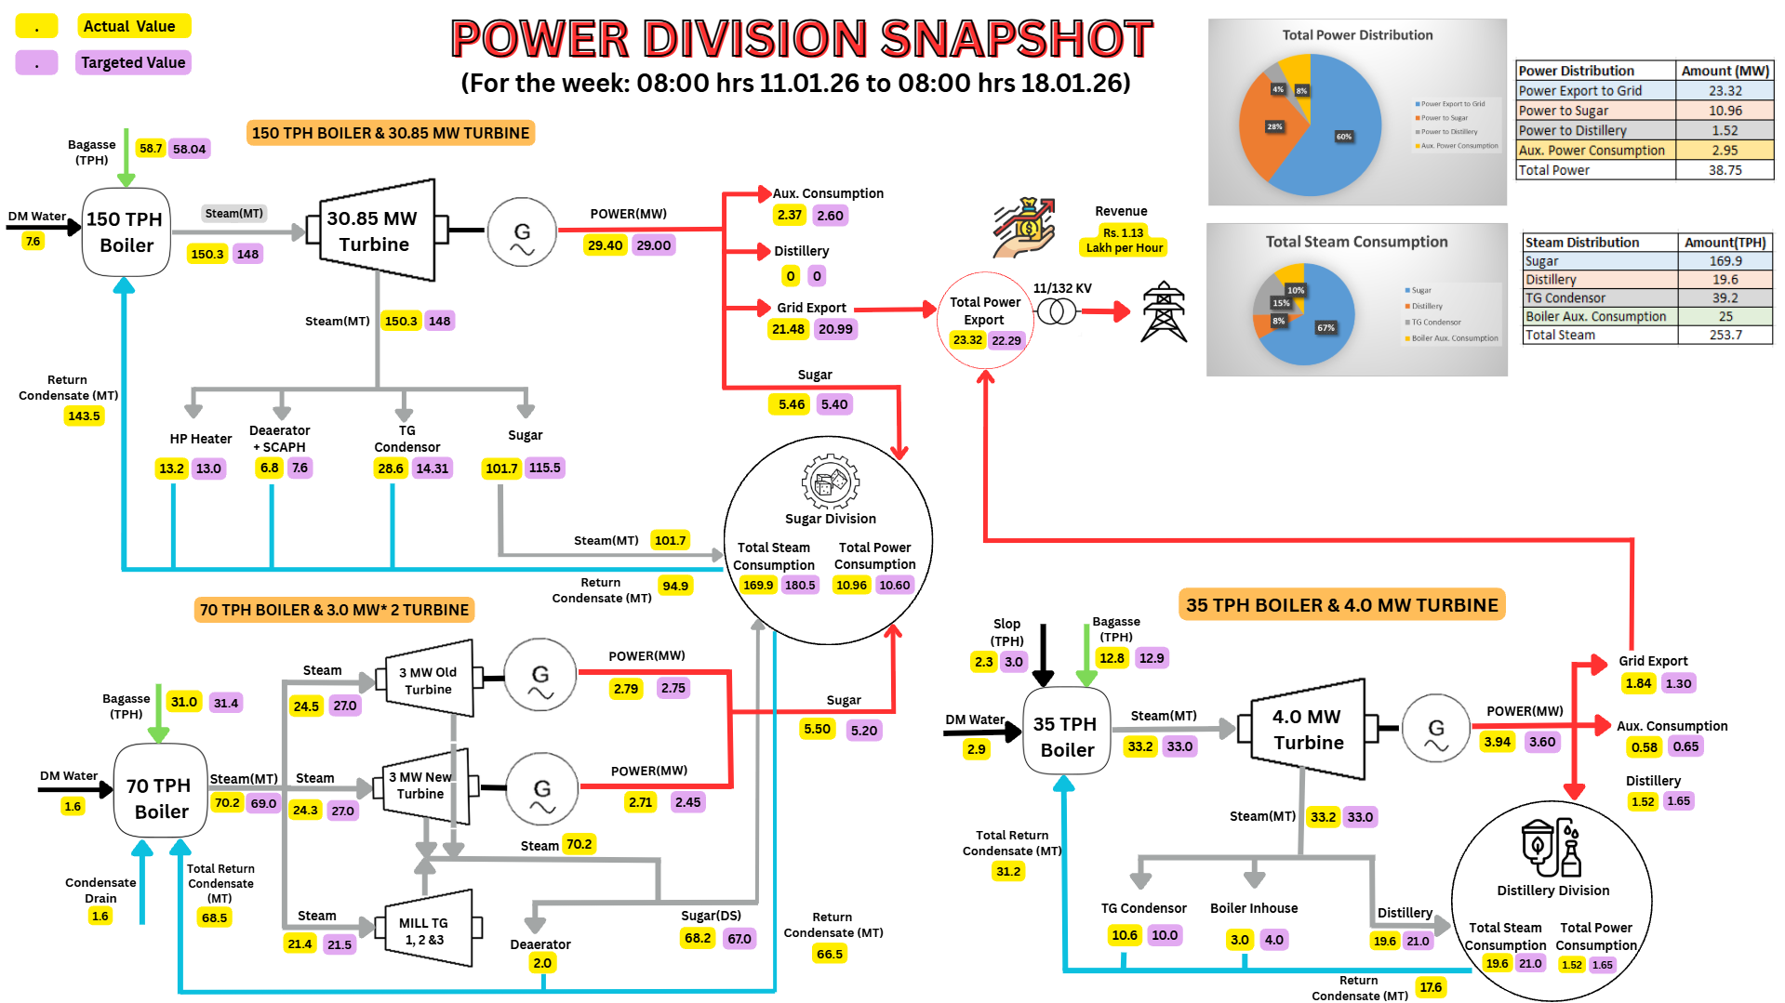

Slide 48
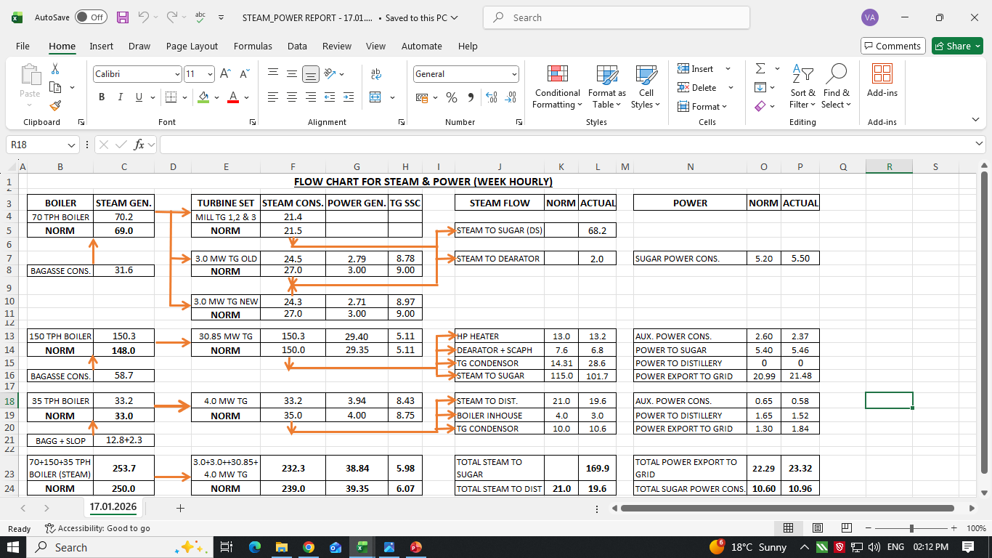
STEAM & POWER FOR THE WEEK

Slide 49
Weekly Performance Snapshot - Power
S.N | Generation & Export | Current Week | Last Week | Till Date
1 | Total Power Generation (LU) | 65.26 | 65.43 | 766.81
2 | Power Export (LU) | 39.18 | 39.79 | 454.70
3 | Power Export (%) | 60.03 | 60.81 | 59.30
 | Power Consumption (% of Gen.) | 39.97 | 39.19 | 40.70
4 | Sugar Plant Process (% of Gen. ) | 28.24 | 27.37 | 28.48
5 | Distillery Plant Process (% of Gen. ) | 3.91 | 3.94 | 3.94
6 | Aux Consumption (% of Gen.) | 7.82 | 7.88 | 8.28
49

Slide 50
Weekly Performance Snapshot – Power
 | Boiler Capacity Utilization | Target | Current Week | Last Week | Till Date (25-26) | Till Date (24-25)
1 | Capacity Utilization - 150 TPH | >144.0 | 150.3 | 151.0 | 150.4 | 143.4
2 | Capacity Utilization – 70 TPH | >64.0 | 70.2 | 70.1 | 67.9 | 65.6
3 | Capacity Utilization – 35 TPH | >33.0 | 33.2 | 33.4 | 32.8 | 32.0
 | Turbine Capacity Utilization
4 | PLF % – 30.85 MW | > 95.00 | 98.02 | 98.29 | 97.24 | 93.04
5 | PLF % – 3.0 MW (O) | > 90.00 | 92.84 | 93.41 | 93.56 | 91.13
6 | PLF % – 3.0 MW (N) | > 75.00 | 90.45 | 89.46 | 87.03 | 81.40
7 | PLF % – 4.0 MW | > 90.00 | 98.62 | 99.32 | 96.39 | 89.01
 | Efficiency
8 | Steam/Fuel Ratio – 150 TPH | ≥2.54 | 2.56 | 2.56 | 2.55 | 2.52
9 | Steam/Fuel Ratio – 70 TPH | ≥2.19 | 2.22 | 2.22 | 2.21 | 2.17
10 | Steam/Fuel Ratio – 35 TPH | ≥1.88 | 2.19 | 2.18 | 2.17 | 2.06
11 | Specific Steam – 30.85 MW | ≤5.20 | 5.10 | 5.12 | 5.13 | 5.12
12 | Specific Steam – 3 MW (O) | ≤9.00 | 8.81 | 8.76 | 8.56 | 8.67
13 | Specific Steam – 3 MW (N) | ≤9.00 | 8.95 | 8.93 | 8.79 | 8.94
14 | Specific Steam – 4 MW | ≤9.20 | 8.39 | 8.40 | 8.55 | 8.95
50

Slide 51
Key Operational Parameters: Overall SPE Division
Plant Availability
Sr. No. | Description | Current Week | Last Week |  | Till Date SS 25 - 26 | Till Date SS 24 - 25
 |  | 11/01/2026 to 17/01/2026 | 04/01/2026 to 10/01/2026 |  | 26/10/2025 to 17/01/2026 | 26/10/2024 to 17/01/2025
1. | 150 TPH Boiler | 100% | 100% |  | 97.89% | 99.99%
2. | 70 TPH Boiler | 100% | 100% |  | 99.35% | 99.72%
3. | 35 TPH Boiler | 100% | 100% |  | 98.22% | 99.18%
4. | 30.85 MW Turbine | 100% | 100% |  | 97.36% | 99.88%
5. | 4 MW Turbine | 100% | 100% |  | 97.65% | 98.88%
6. | 3 MW_Old Turbine | 100% | 100% |  | 98.82% | 99.42%
7. | 3 MW_New Turbine | 100% | 100% |  | 95.93% | 97.79%
8. | 132 KV GRID | 99.58% | 100% |  | 99.76% | 99.86%

Slide 52
Key Operational Parameters: Overall Power Generation , Export and Consumption of SPE Division
Sr. No. | Particulars | UOM | Target | Current Week |  | Last Week |  | Till date SS 25-26 |  | Till date SS 24-25
 | Operation | Days | Avg. | 7 | Avg. | 7 | Avg. | 84 | Avg. | 83 | Avg.
1. | 30.85 MW STG | MWH | 29.00 | 4940.00 | 29.40 | 4954.00 | 29.49 | 58809.00 | 29.17 | 55599.00 | 27.91
2. | 3 MW _Old STG | MWH | 2.75 | 467.91 | 2.79 | 470.81 | 2.80 | 5456.27 | 2.81 | 5445.65 | 2.73
3. | 3 MW _ New STG | MWH | 2.45 | 455.87 | 2.71 | 450.90 | 2.68 | 5013.18 | 2.61 | 4688.61 | 2.35
4. | 4.0 MW STG | MWH | 3.60 | 662.70 | 3.94 | 667.40 | 3.97 | 6835.90 | 3.86 | 7402.90 | 3.72
5. | Power Exported | MWH | 22.00 | 3918.00 | 23.32 | 3979.00 | 23.68 | 45470.00 | 22.55 | 43153.00 | 21.66
6. | Sugar Plant Consumption | MWH | 10.60 | 1841.78 | 10.96 | 1787.41 | 10.64 | 22135.93 | 10.98 | 20257.26 | 10.17
7. | Distillery Plant Consumation | MWH | 1.65 | 255.04 | 1.52 | 257.97 | 1.54 | 3023.26 | 1.57 | 3018.65 | 1.57
8. | 30 MW Cogen Aux. Cons. | MWH | 2.60 | 397.79 | 2.37 | 403.46 | 2.40 | 4878.72 | 2.42 | 4928.82 | 2.47
9. | 4.0 MW Cogen Aux. Cons. | MWH | 0.65 | 98.26 | 0.58 | 97.83 | 0.58 | 1153.84 | 0.60 | 1154.15 | 0.60

Slide 53
Key Operational Parameters: Overall Power Generation , Export and Consumption of SPE Division
Sr. No. | Particulars | UOM | Target | Current Week | Last Week | Till date SS 25-26 | Till date SS 24-25
 | Operation | Days | Avg. | 7 | 7 | 84 | 83
1. | Capacity Utilization – 30.85 MW STG Set | % | > 95.00 | 98.02 | 98.29 | 97.24 | 93.04
2. | Capacity Utilization – 3.0 MW _ Old STG Set | % | > 90.00 | 92.84 | 93.41 | 93.56 | 91.13
3. | Capacity Utilization – 3.0 MW _ New STG Set | % | > 75.00 | 90.45 | 89.46 | 87.03 | 81.40
4. | Capacity Utilization – 4.0 MW STG Set | % | > 90.00 | 98.62 | 99.32 | 96.39 | 89.01
5. | Aux. Consumption of 30.85 MW | % | < 9.20 | 8.05 | 8.14 | 8.30 | 8.86
6. | Aux. Consumption of 4 MW | % | < 20.00 | 14.82 | 14.66 | 15.50 | 16.88
7. | Power Consumption Per Ton of Cane Crushed | KWH/Ton on Cane | < 31.54 | 30.49 | 29.73 | 31.87 | 32.44

Slide 54
KEY OPERATIONAL PARAMETERS 30.85 MW PP (150 TPH BOILER)
Parameters | UOM | DATE
 |  | 11-Jan | 12-Jan | 13-Jan | 14-Jan | 15-Jan | 16-Jan | 17-Jan
Cane Crushed | QTL | 108000 | 106000 | 100000 | 108000 | 107000 | 102000 | 103500
Steam Gen. | MT/ HR | 150.6 | 151.1 | 149.4 | 150.2 | 150.8 | 150.4 | 149.5
Power Gen. | MWH | 29.29 | 29.58 | 29.29 | 29.00 | 29.29 | 29.63 | 29.75
Bag. Moisture | % | 50.0 | 49.9 | 50.0 | 49.8 | 50.0 | 49.9 | 50.0
GCV : Bagasse | KCal/ Kg | 2280 | 2284 | 2280 | 2289 | 2280 | 2284 | 2280
Gross SHR of PP (Kcal/Kwh) | 25-26 | 2764 | 2764 | 2752 | 2766 | 2754 | 2784 | 2801
 | 24-25 | 2725 | 2734 | 2723 | 2758 | 2787 | 2933 | 2800
Gross Boiler Eff.(71.95as per PG test) | % | 71.30 | 71.16 | 71.20 | 71.25 | 70.94 | 70.83 | 71.00

Slide 55
BAGASSE GENERATION & CONSUMPTION DETAILS
Particulars | UOM
Operation days | NOS.
Cane Crushed | MT
Bagasse Received | MT
Bagasse Stock | MT
Steam% Cane | %
Hourly | Current Week | Last Week | Hourly (Till Date)
Target | SS 25-26 | SS 25-26 | SS 25-26 | SS 24-25
 | 7 | 7 | 84 | 83
416.7 | 437.2 | 438.7 | 420.5 | 389.7
112.5 | 121.3 | 120.0 | 113.7 | 103.3
 | 26851 | 23790 | 26851 | 29728
 | 38.87 | 38.93 | 39.79 | 40.86
Weekly | Current Week | Last Week
Target | SS 25-26 | SS 25-26
7 | 7 | 7
70000 | 73450 | 73700
18900 | 20385 | 20163
Till Date
SS 25-26 | SS 24-25
84 | 83
847720 | 776330
229195 | 205690
Steam Gen. 70 TPH Boiler | MT
Bag. Cons. 70 TPH Boiler | MT
Steam to Fuel Ratio
64.0 | 70.2 | 70.1 | 67.9 | 65.6
29.2 | 31.0 | 31.6 | 30.8 | 30.3
>2.19 | 2.22 | 2.22 | 2.21 | 2.17
10752 | 11790 | 11772
4906 | 5311 | 5303
>2.19 | 2.22 | 2.22
131969 | 130769
59821 | 60276
2.21 | 2.17
Steam Gen. 150 TPH Boiler | MT
Bag. Cons. 150 TPH Boiler | MT
Steam to Fuel Ratio
144.0 | 150.3 | 151.0 | 150.4 | 143.4
56.7 | 58.7 | 59.0 | 59.0 | 56.9
>2.54 | 2.56 | 2.56 | 2.55 | 2.52
24192 | 25251 | 25374
9526 | 9864 | 9912
>2.54 | 2.56 | 2.56
303252 | 285678
118929 | 113285
2.55 | 2.52
Steam Gen. (35 T Boiler) | MT
Bag. Cons. (35 T Boiler) | MT
Slop Cons. (35 T Boiler) | MT
Steam to Fuel Ratio
33.0 | 33.2 | 33.4 | 32.8 | 32.0
12.0 | 12.8 | 12.7 | 12.5 | 13.0
3.0 | 2.3 | 2.6 | 2.7 | 2.6
>1.88 | 2.19 | 2.18 | 2.17 | 2.06
5544 | 5571 | 5605
2016 | 2149 | 2129
504 | 393 | 438
>1.88 | 2.19 | 2.18
63029 | 61472
23960 | 24874
5100 | 4989
2.17 | 2.06

Slide 56
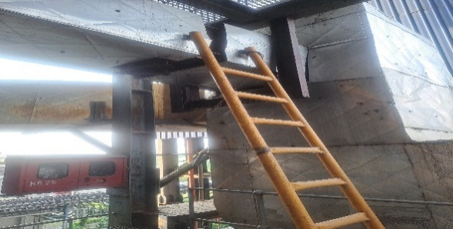
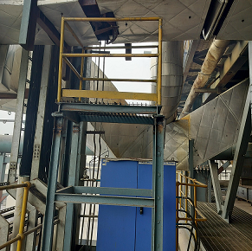
150 TPH BOILER OFA DUCT- UNSAFE CONDITION
Ladder replaced with proper platform for the air damper operate
Cage ring & Handrail not found in monkey ladder
BEFORE
AFTER

Slide 57
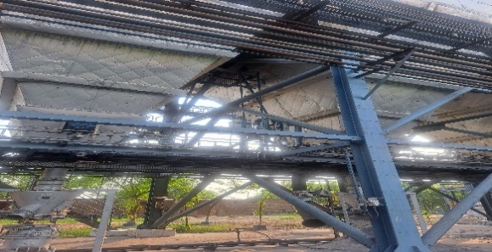
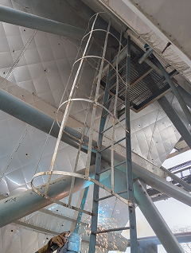
150 TPH BOILER ASH HANDLING SYSTEM - UNSAFE CONDITION
CAGE RING
BEFORE
AFTER

Slide 58
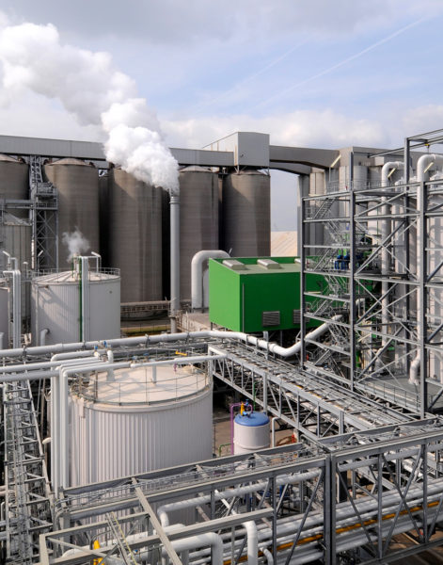
DISTILLERY UNIT

Slide 59
QUALITY CONTROL

Slide 60
Summary For Season 25-26

Slide 61
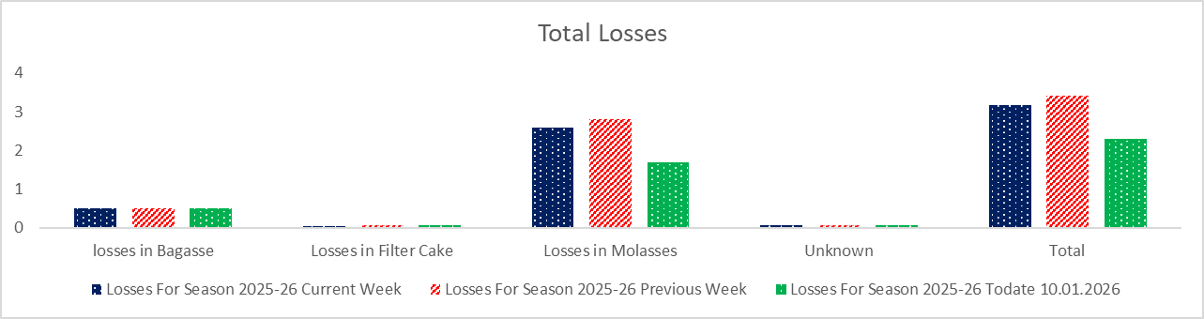
TOTAL LOSSES

Slide 62
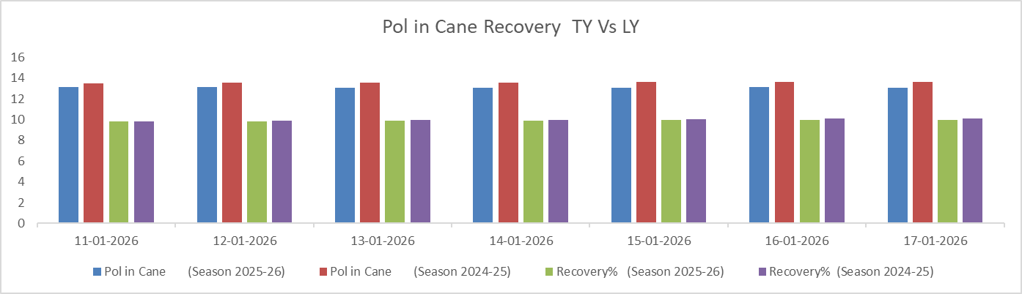
Pol in Cane Comparison

Slide 63
Certification Status
Sr. No. | Certification | Implementation | Validity | Next Audit | Remark
1 | FSSC: 22000:2018 | MAY-2019 | MAY-28 | FEB-26 | Next surveillance audit due in Feb-26
2 | ISO: 9001:2015 | OCT-2011 | OCT-26 | OCT-27 | Next due in Oct-2025
3 | EnMS, ISO: 50001:2018 | JAN-26 (Tentative) | - | - | Documentation in process and Gap assessment audit scheduled plan in NOV-25
4 | KOSHER | 30 OCT-25 | 29 OCT-26 | SEP-26- | Included with Speciality Sugar
5 | IMS (ISO: 9001, ISO:14001 & ISO 45001:2018 | APR-26 (Tentative) | - | - | Implementation process starts at our hand and documentation part in process
6 | IP License | SEP-22 | SEP-27 | SEP-27 | BP Sucrose include during SS 2024-25 and plan to include USP Sucrose during SS 2025-26

Slide 64
KPI Target Vs Achieved

Slide 65
Cane Crushed Data Capacity Wise

Slide 66

IT

Slide 67
Executive Summary
- Point 1: Effectively configured systems for sugarcane procurement at both gate and collection centers, enhancing process efficiency and transparency.
Point 2: Initiated routine operational activities for the crushing season, aligning teams and resources for smooth execution.
Point 3 :Installation of an NPR camera at the new molasses loading point is in progress.
Point 4:OPS server upgrade is underway to ensure smooth application performance.
Point 5 : Internet bandwidth upgrade from 50 Mbps to 100 Mbps is in progress.
Point 6 :Installation of the vehicle positioning system at the gate tare weighbridge is currently in 2 completed & 1 is under process.
67

Slide 68
General Observation
S. No. | Description
1 | Active Saksham App Growers: Installed – 40,540 / Active – 20,415
2 | GPS Installed in Center Trucks: 298
3 | Weighbridges (Gate + Centers): Total – 107, Active – 107
4 | Truck Received & Total Weight: 20675 NOS Trucks / 5294908 QTLS
5 | This Week Truck Received & Weight: 1679 NOS Trucks / 457991 QTLS
6 | Total Purchase (Grower & Purchy): Grower – 51486 NOS , Purchy 198856– NOS Weight 8500369- QTLS
7 | This Week Purchase (Grower & Purchy): Grower – 12515 NOS, Purchy – 17252 NOS ,Weight – 735671 QTLS QTLS
8 | FY 2024-25(Grower & Purchy): -62703 NOS ,Purchy -339568 NOS, Weight -14416592 ,QTLS
9 | FY 2024-25 Till 10 Jan (Grower & Purchy):- Grower-52989, Nos Purchy -180860, NOS Weight -7786924 QTLS

Slide 69


EHS

Slide 70
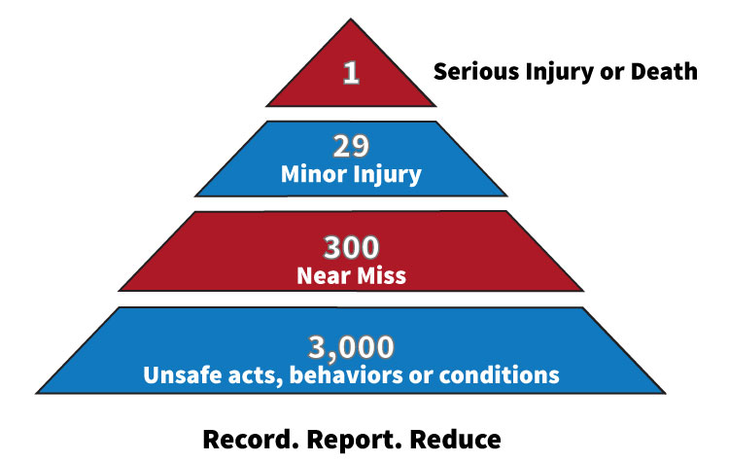
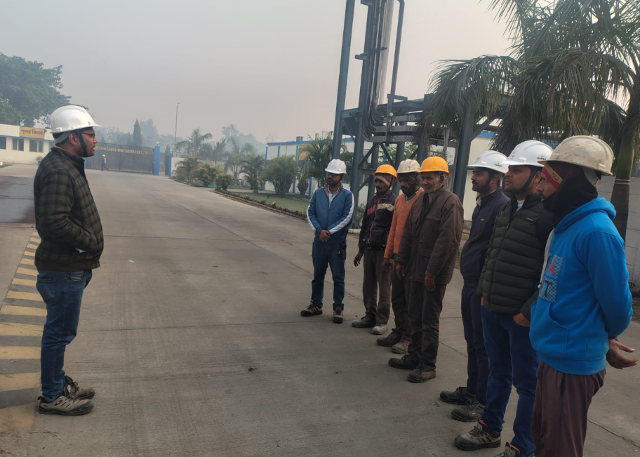
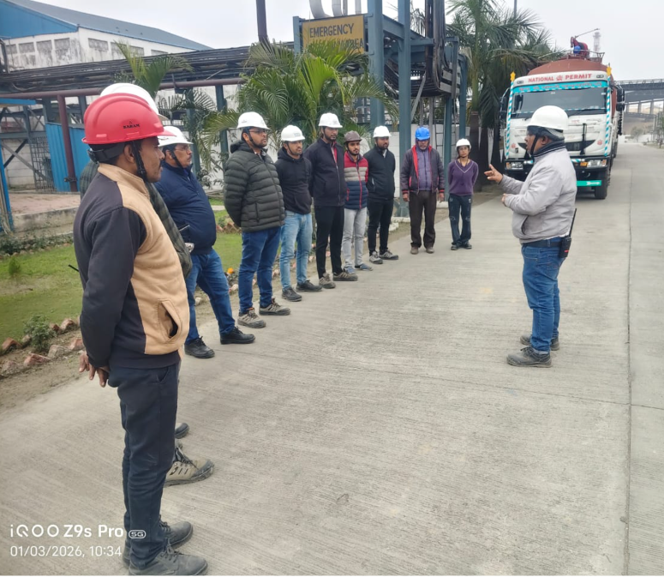
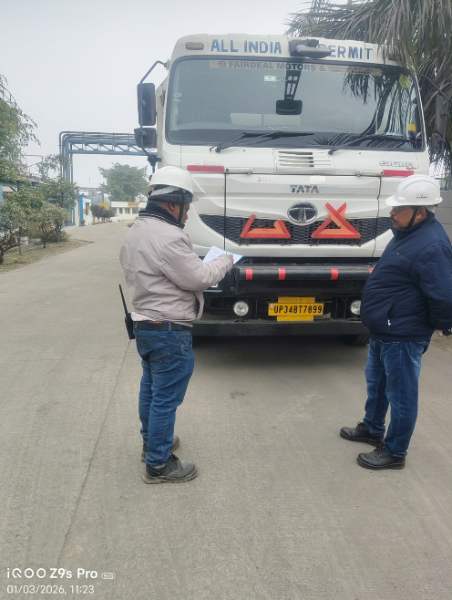
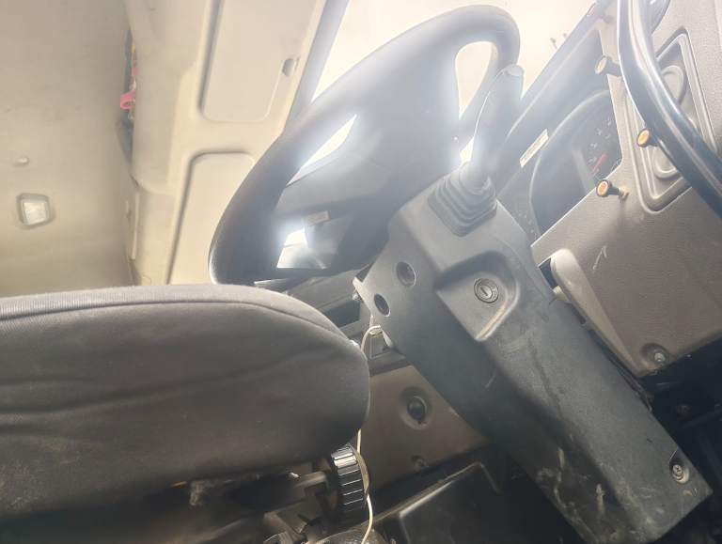
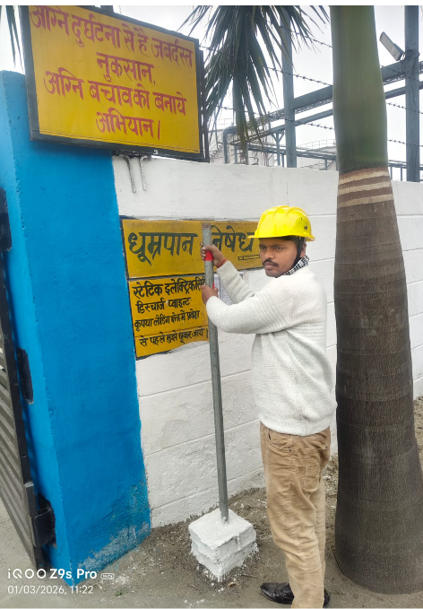
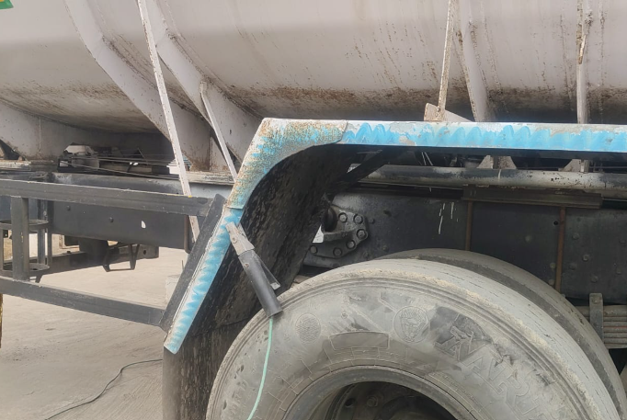
EHS
Sr No | Incident | ^{3rd} Week Jan-26
1 | Near Miss | 1
2 | First Aid | 0
3 | Minor | 0
4 | Major/Fatality | 0
5 | Fire Incident | 0
6 | Unsafe Act/unsafe behaviour Unsafe conditions | 10 6
7 | Training conducted Total Participants | 8 56
New Initiatives
Implementation of reflection/radium tapes ( Paint/tapes).at both the roadside trees and pols for proper marking and clearance of way. For cane vehicles in foggy season)
3. Work Based Tool -Box Training conducted.
.
TBT at Distillery
TBT at Sugar

Slide 71
Bore Well Water Details

Slide 72
Bore Well Water Details

Slide 73
Effluent Flow & Parameters

Slide 74


Thank You!

